Slide 1

Advanced Probabilistic Machine Learning
Ralf Herbrich, Rainer Schlosser
Exact Inference

Slide 2
Overview
Factor Graphs
Marginalization by Importance Sampling
Marginalization by the Sum-Product Algorithm
Practical Considerations in Message Passing
Application: Bayesian Regression

Slide 3
Overview
Factor Graphs
Marginalization by Importance Sampling
Marginalization by the Sum-Product Algorithm
Practical Considerations in Message Passing
Application: Bayesian Regression

Slide 4
Inference in Probabilistic Models
Inference: In order to learn from data $D$we follow a three-step procedure
Modelling: Formulate a joint model $p\left(θ,D\right)$ of parameters $θ=θ_{1},…,θ_{n}$ and data $D$
Conditioning: Clamp the variables that represent data $D$ (as they are observed)
Marginalize: Sum-out all variables that we are not interested in (latent parameters)
Example: Two player game with one winner
Modelling: Parameters $θ=\left(s_{1},s_{2},p_{1},p_{2}\right)$ are skills and performances; data is $y∈\left\{−1,+1\right\}$
Conditioning: Player 1 wins ($y=1$)
Marginalize: We are only interested in the skills and need to sum-out $p_{1}$ and $p_{2}$
$$S_{1}$$
$$S_{2}$$
$$P_{1}$$
$$P_{2}$$
$$Y$$
$$p\left(s_{1},s_{2},p_{1},p_{2},y\right)=$$
$$𝒩\left(s_{1};μ_{1},σ_{1}^{2}\right)⋅𝒩\left(s_{2};μ_{2},σ_{2}^{2}\right)$$
$$⋅𝒩\left(p_{1};s_{1},β^{2}\right)⋅𝒩\left(p_{2};s_{2},β^{2}\right)$$
$$⋅𝕀\left(y\left(p_{1}−p_{2}\right)>0\right)$$
$$p\left(s_{1},s_{2},p_{1},p_{2}|y=1\right)∝𝒩\left(s_{1};μ_{1},σ_{1}^{2}\right)⋅𝒩\left(s_{2};μ_{2},σ_{2}^{2}\right)⋅𝒩\left(p_{1};s_{1},β^{2}\right)⋅𝒩\left(p_{2};s_{2},β^{2}\right)⋅𝕀\left(p_{1}−p_{2}>0\right)$$
$$p\left(s_{1},s_{2}|y=1\right)∝p\left(s_{1},s_{2}\right)⋅\int_{−∞}^{+∞}{\int_{−∞}^{+∞}{𝒩\left(p_{1};s_{1},β^{2}\right)⋅𝒩\left(p_{2};s_{2},β^{2}\right)⋅𝕀\left(p_{1}−p_{2}>0\right) dp_{1}dp_{2}}}$$

Slide 5

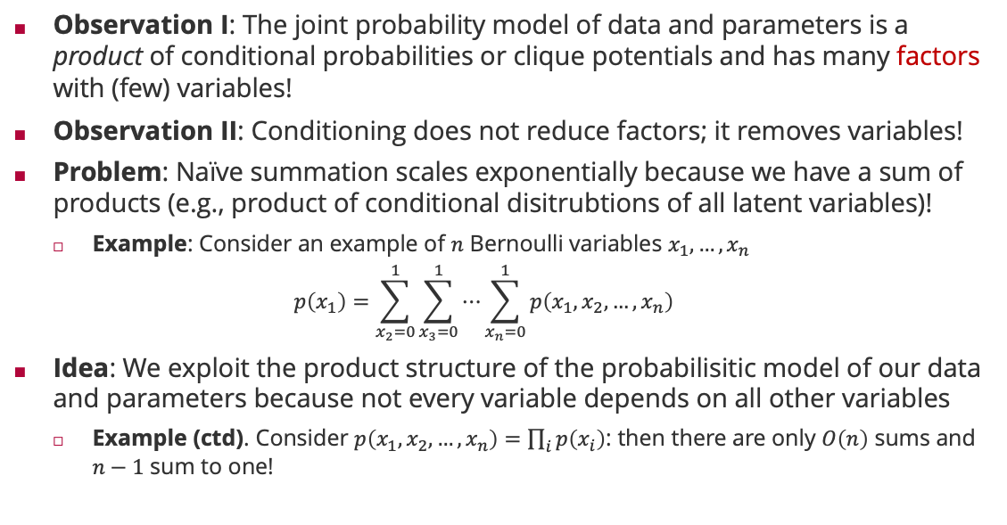
Factors, Variables and Probabilistic Inference
Observation I: The joint probability model of data and parameters is a product of conditional probabilities or clique potentials and has many factors with (few) variables!
Observation II: Conditioning does not reduce factors; it removes variables!
Problem: Naïve summation scales exponentially because we have a sum of products (e.g., product of conditional disitrubtions of all latent variables)!
Example: Consider an example of $n$ Bernoulli variables $x_{1},…,x_{n}$
$$p\left(x_{1}\right)=\sum_{x_{2}=0}^{1}{\sum_{x_{3}=0}^{1}{⋯\sum_{x_{n}=0}^{1}{p\left(x_{1},x_{2},…,x_{n}\right)}}}$$
Idea: We exploit the product structure of the probabilisitic model of our data and parameters because not every variable depends on all other variables
Example (ctd). Consider $p\left(x_{1},x_{2},…,x_{n}\right)=\prod_{i}{p\left(x_{i}\right)}$: then there are only $O\left(n\right)$ sums and $n−1$ sum to one!
$2^{n−1}$ summations

Slide 6





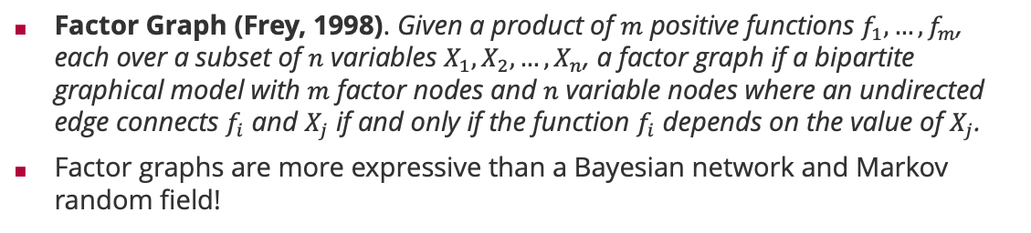








Factor Graphs
Factor Graph (Frey, 1998). Given a product of $m$ positive functions $f_{1}, …,f_{m}$, each over a subset of $n$ variables $X_{1},X_{2},…,X_{n}$, a factor graph if a bipartite graphical model with $m$ factor nodes and $n$ variable nodes where an undirected edge connects $f_{i}$ and $X_{j}$ if and only if the function $f_{i}$ depends on the value of $X_{j}$.
Factor graphs are more expressive than a Bayesian network and Markov random field!
Brendan Frey (1968 – )
Bayesian network
Corresponding factor graph
Factor graph with more structure
$$X_{1}$$
$$X_{2}$$
$$X_{1}$$
$$X_{2}$$
$$X_{1}$$
$$X_{2}$$
$$X_{3}$$
$$X_{3}$$
$$X_{3}$$
$$p\left(x_{1},x_{2},x_{3}\right)=p\left(x_{1}\right)⋅p\left(x_{2}\right)⋅p\left(x_{3}|x_{1},x_{2}\right)$$
$$p\left(x_{1},x_{2},x_{3}\right)=f_{1}\left(x_{1}\right)⋅f_{2}\left(x_{2}\right)⋅f_{3}\left(x_{3},x_{1},x_{2}\right)$$
$$p\left(x_{1},x_{2},x_{3}\right)=f_{1}\left(x_{1}\right)⋅f_{2}\left(x_{2}\right)⋅f_{3}\left(x_{1},x_{3}\right)⋅f_{4}\left(x_{2},x_{3}\right)$$
Structure in $p\left(x_{3}|x_{1},x_{2}\right)$

Slide 7
Overview
Factor Graphs
Marginalization by Importance Sampling
Marginalization by the Sum-Product Algorithm
Practical Considerations in Message Passing
Application: Bayesian Regression

Slide 8
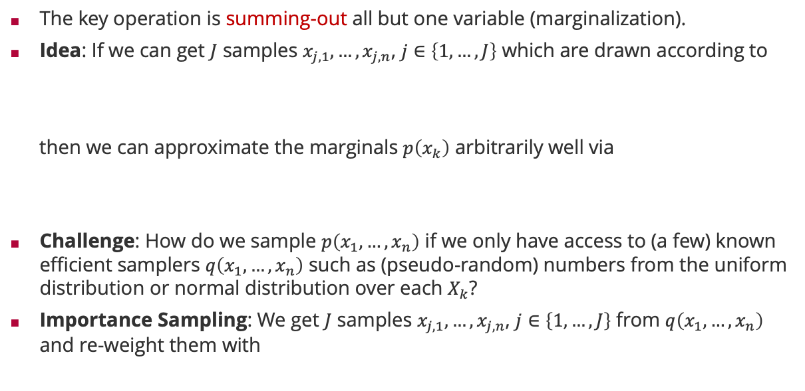
Inference by Importance Sampling
The key operation is summing-out all but one variable (marginalization).
Idea: If we can get $J$ samples $x_{j,1},…,x_{j,n}$, $j∈\left\{1,…,J\right\}$ which are drawn according to
then we can approximate the marginals $p\left(x_{k}\right)$ arbitrarily well via
Challenge: How do we sample $p\left(x_{1},…,x_{n}\right)$ if we only have access to (a few) known efficient samplers $q\left(x_{1},…,x_{n}\right)$ such as (pseudo-random) numbers from the uniform distribution or normal distribution over each $X_{k}$?
Importance Sampling: We get $J$ samples $x_{j,1},…,x_{j,n}$, $j∈\left\{1,…,J\right\}$ from $q\left(x_{1},…,x_{n}\right)$ and re-weight them with
$$p\left(x_{1},…,x_{n}\right)∝\prod_{i=1}^{m}{f_{i}\left(x_{1},…,x_{n}\right)}$$
$$p\left(x_{k}\right)≈\frac{1}{J}\sum_{j=1}^{J}{δ\left(x_{k}−x_{j,k}\right)}$$
$$\frac{p\left(x_{j,1},…,x_{j,n}\right)}{q\left(x_{j,1},…,x_{j,n}\right)}$$
Importance weight

Slide 9
Weighted-Empirical Distribution
Weighted Empirical Distribution. Given a sample $x=\left(x_{1},…,x_{n}\right)∈ℝ^{n}$ and $n$ coefficients $w=\left(w_{1},…,w_{n}\right)∈ℝ^{+^{n}}$, a random variable $X∈ℝ$ is said to have the weighted empirical distribution $ℰ\left(⋅;x,w\right)$ if the density is
$$p\left(x;x,w\right)=\frac{1}{Z}⋅\sum_{i=1}^{n}{w_{i}⋅δ\left(x−x_{i}\right)} , Z≔\sum_{j=1}^{n}{w_{j}}$$
Cumulative Distribution Function. Let $X∼ℰ\left(⋅;x,w\right)$ be distributed according to the weighted empirical distribution. Then the cumulative distribution is given by
$$\int_{−∞}^{t}{ℰ\left(x;x,w\right) dx}=\frac{1}{Z}⋅\sum_{i=1}^{n}{w_{i}⋅𝕀\left(x_{i}≤t\right)}$$
Moments. Let $X∼ℰ\left(⋅;x,w\right)$ be distributed according to the weighted empirical distribution. Then we have for the $k$-th moment $E\left[X^{k}\right]$
$$E\left[X^{k}\right]=\frac{1}{Z}⋅\sum_{i=1}^{n}{w_{i}⋅x_{i}^{k}}$$
Normalization constant so that $1/Z⋅\sum_{i=1}^{n}{w_{i}}=1$
Counting all samples that are smaller than $t$ weighing each by ${1/Z⋅w}_{i}$
Weighted sample averages

Slide 10
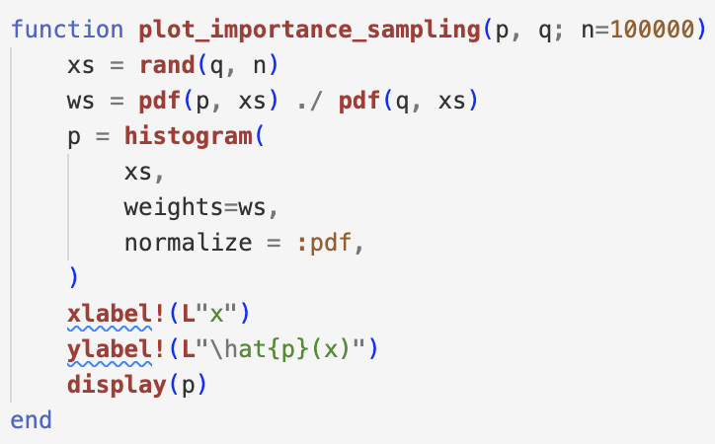
Importance Sampling in Pictures
Too little weight in the proposal
$$p\left(x\right)=𝒩\left(x;0,1\right)$$
$$q\left(x\right)=𝒩\left(x;0,1\right)$$
$$q\left(x\right)=𝒩\left(x;1.5,1\right)$$
$$q\left(x\right)=𝒰\left(x;−2.5,2.5\right)$$
Zero weight in the proposal

Slide 11
Marginalization by Sampling a Factor Graph
Importance Sampling
Given: Proposal distributions $q_{1}\left(⋅\right),…,q_{n}\left(⋅\right)$ for $X_{1},…,X_{n}$
For $j∈\left\{1,…,J\right\}$
Sample $x_{j,1}∼q_{1}$, $x_{j,2}∼q_{2}$ up to $x_{j,n}∼q_{n}$ into $x_{j}=\left(x_{j,1},…,x_{j,n}\right)$
Compute
$$w_{j}={\prod_{i=1}^{m}{f_{i}\left(x_{j,1},…,x_{j,n}\right)}}/{\prod_{k=1}^{n}{q_{k}\left(x_{j,k}\right)}}$$
Return: $\left\{x_{j}\right\}∈ℝ^{J×n}$ and $w∈{ℝ^{+}}^{J}$ as weighted empirical distribution
Pros
Sampling of the $x_{j}$ is parallel rather than sequential (as in a Bayesian network)!
The weights can also be computed in parallel!
Cons
If the proposal $\prod_{k=1}^{n}{q_{k}\left(⋅\right)}$ is far from the marginal of $\prod_{i=1}^{m}{f_{i}\left(⋅,…,⋅\right)}$ then convergence is slow

Slide 12
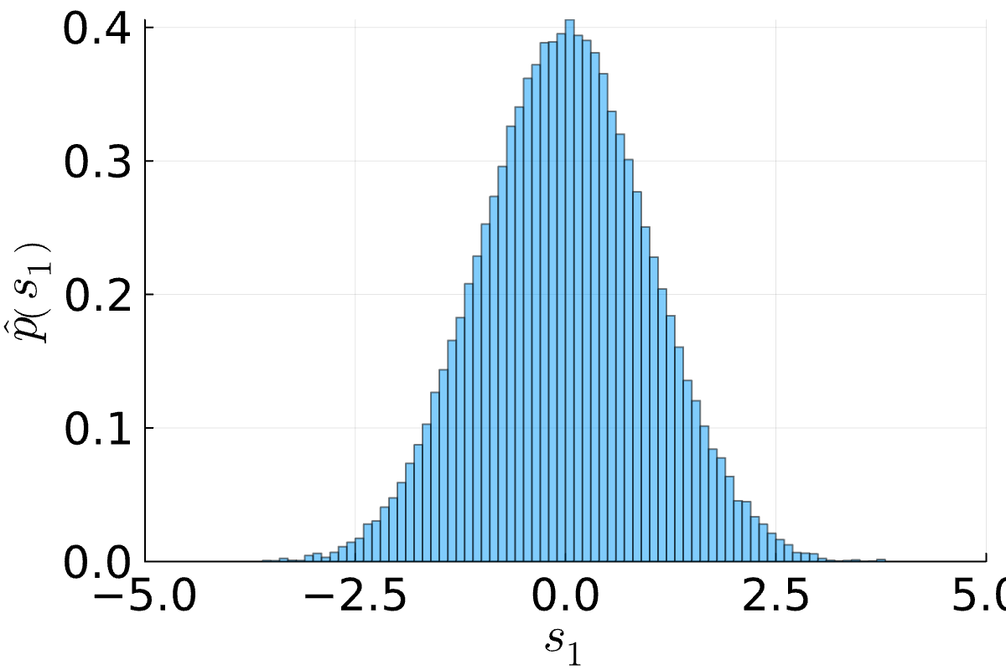

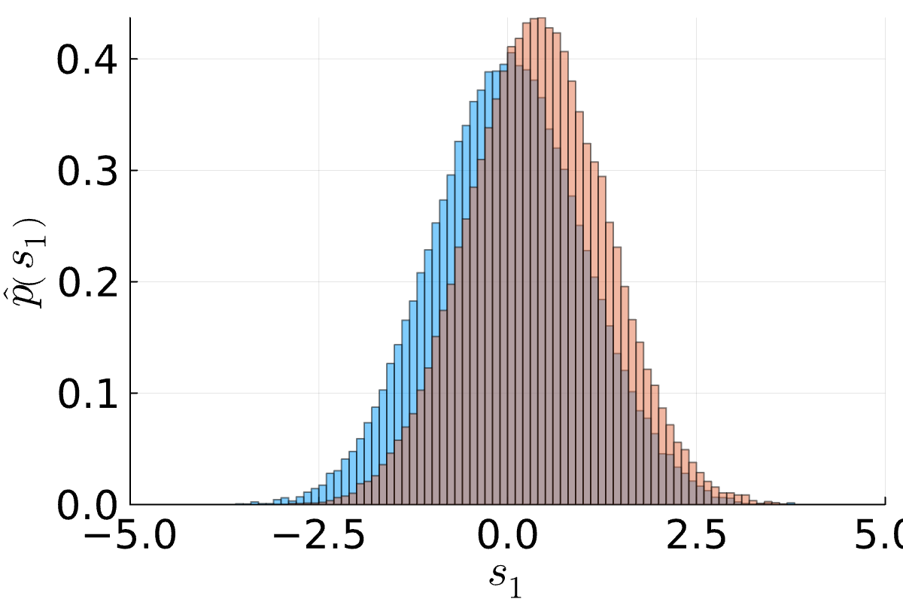
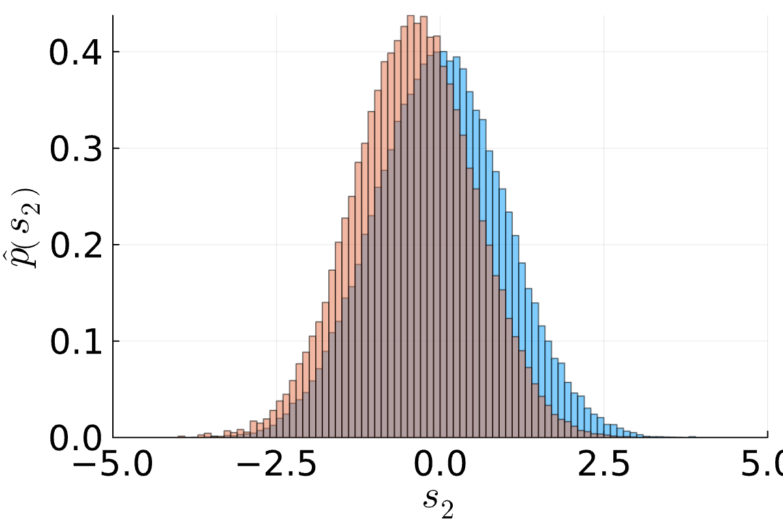
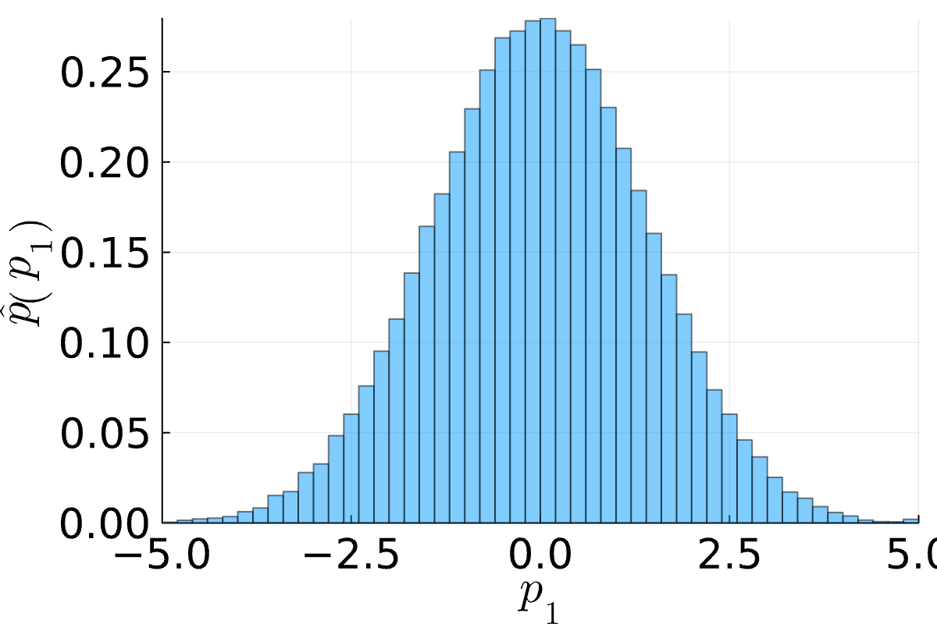

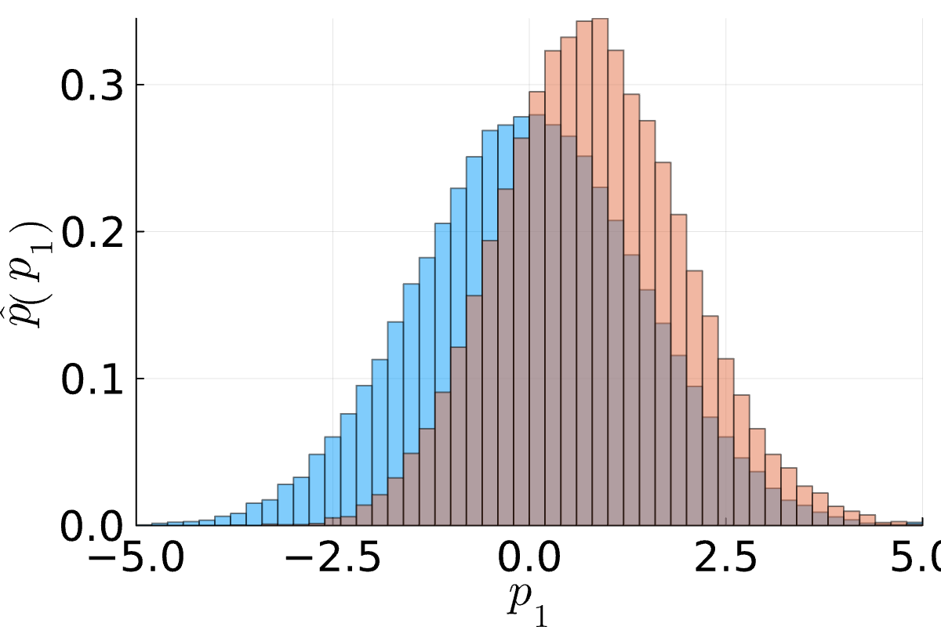
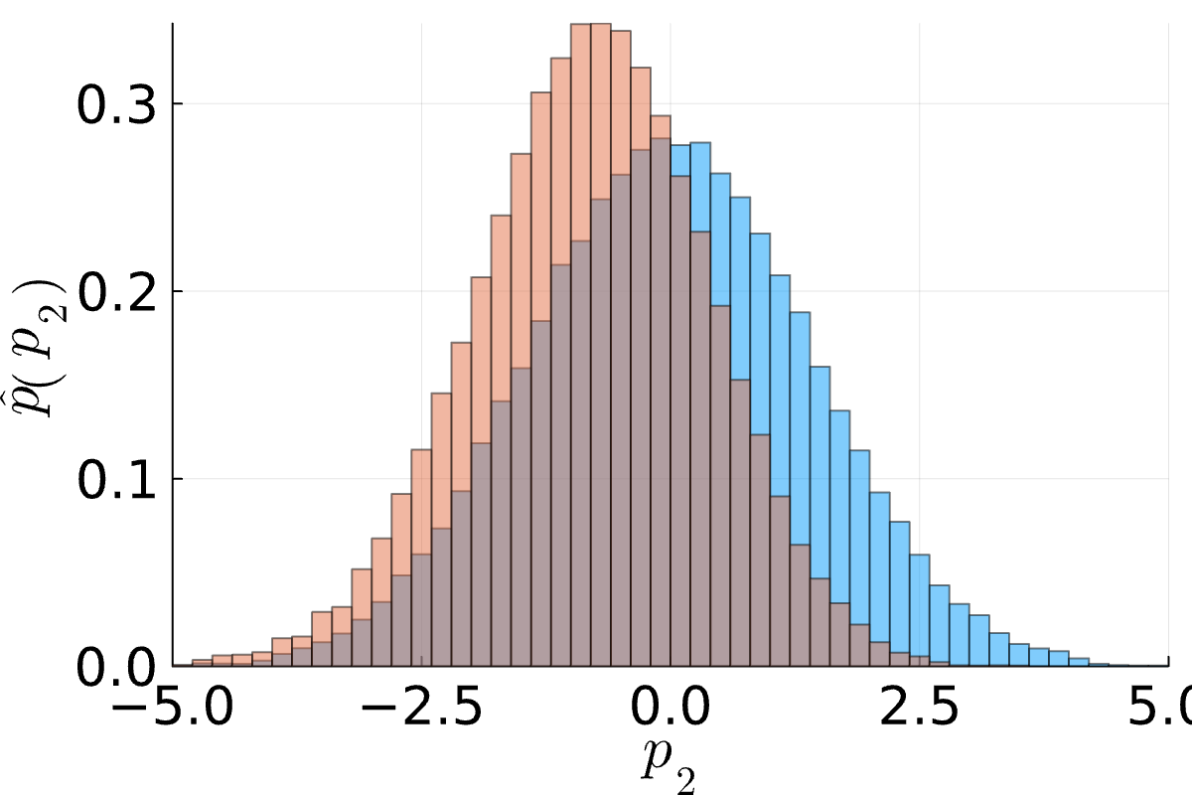
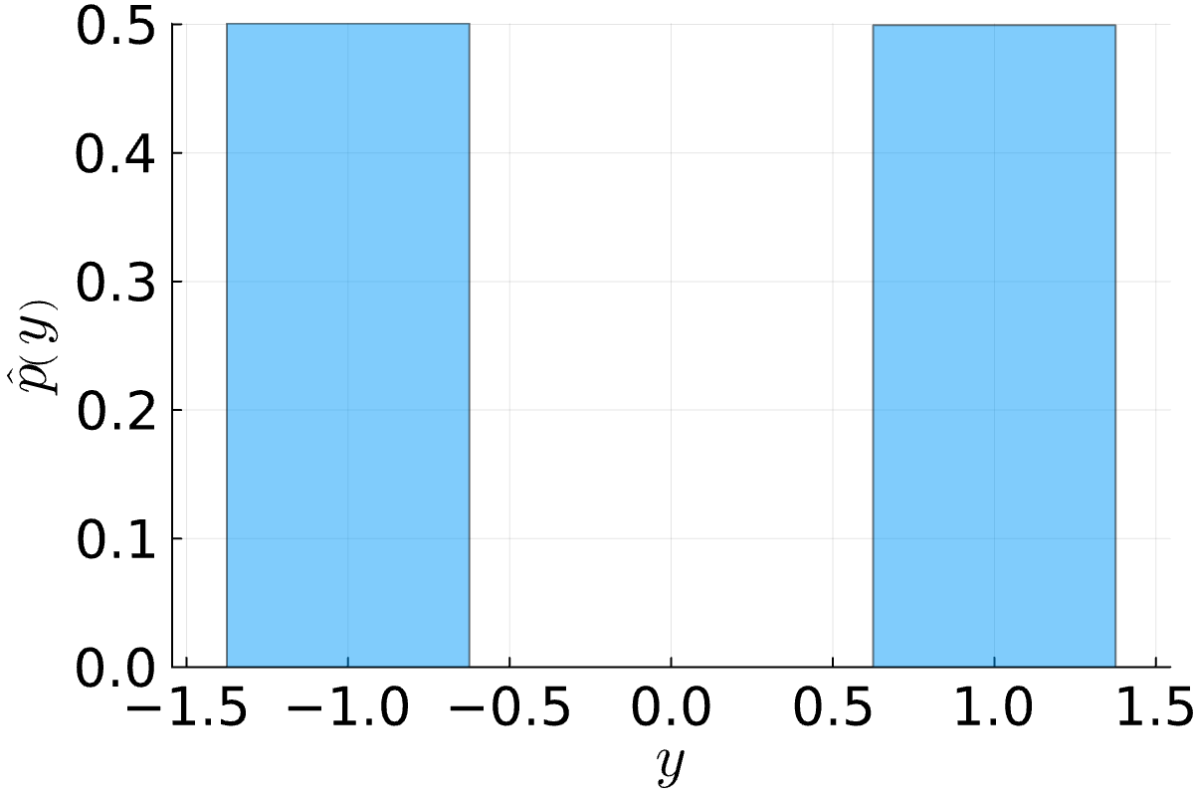
Marginalization by Sampling a Factor Graph: Example
$$𝒩\left(s_{1};μ_{1},σ_{1}^{2}\right)⋅𝒩\left(s_{2};μ_{2},σ_{2}^{2}\right)⋅𝒩\left(p_{1};s_{1},β^{2}\right)⋅𝒩\left(p_{2};s_{2},β^{2}\right)⋅𝕀\left(y\left(p_{1}−p_{2}\right)>0\right)$$
$$S_{1}$$
$$S_{2}$$
$$P_{1}$$
$$P_{2}$$
Without match outcome
With match outcome ($y=1$)
$$Y$$
$$S_{1}$$
$$S_{2}$$
$$S_{1}$$
$$S_{2}$$
$$P_{1}$$
$$P_{2}$$
$$P_{1}$$
$$P_{2}$$
$$Y$$

Slide 13
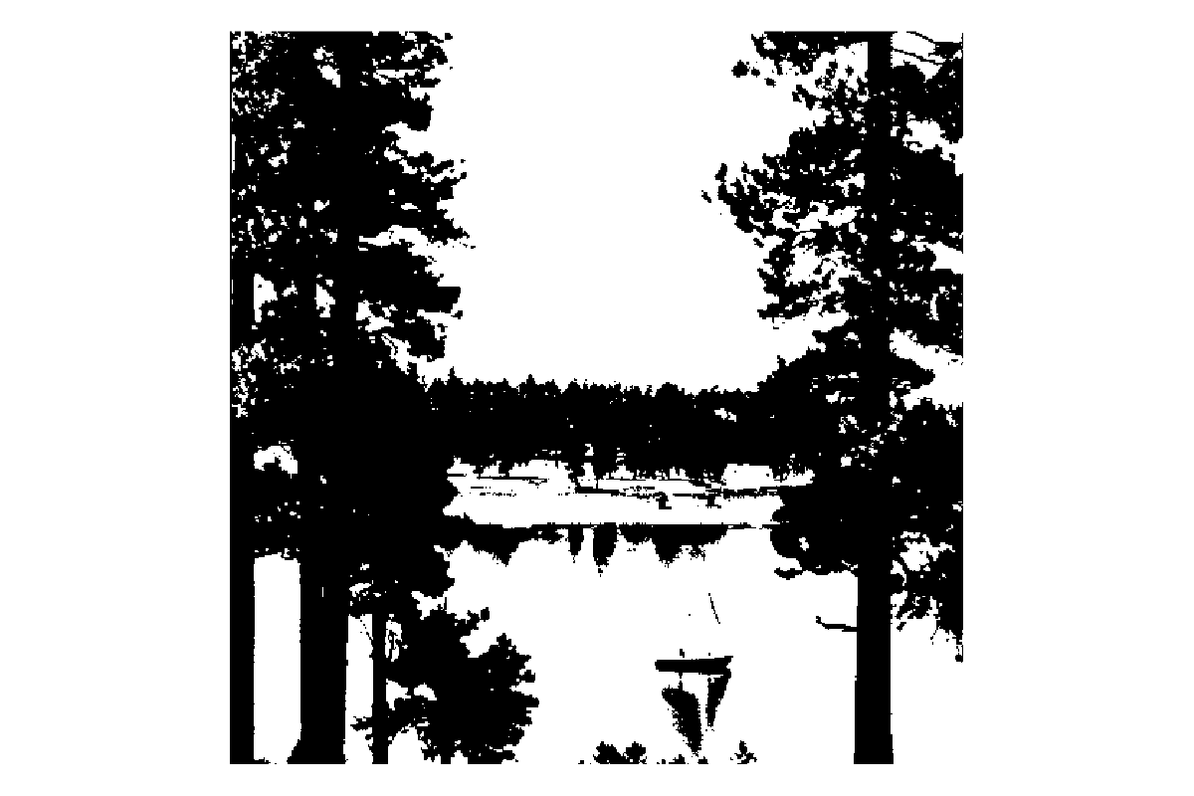
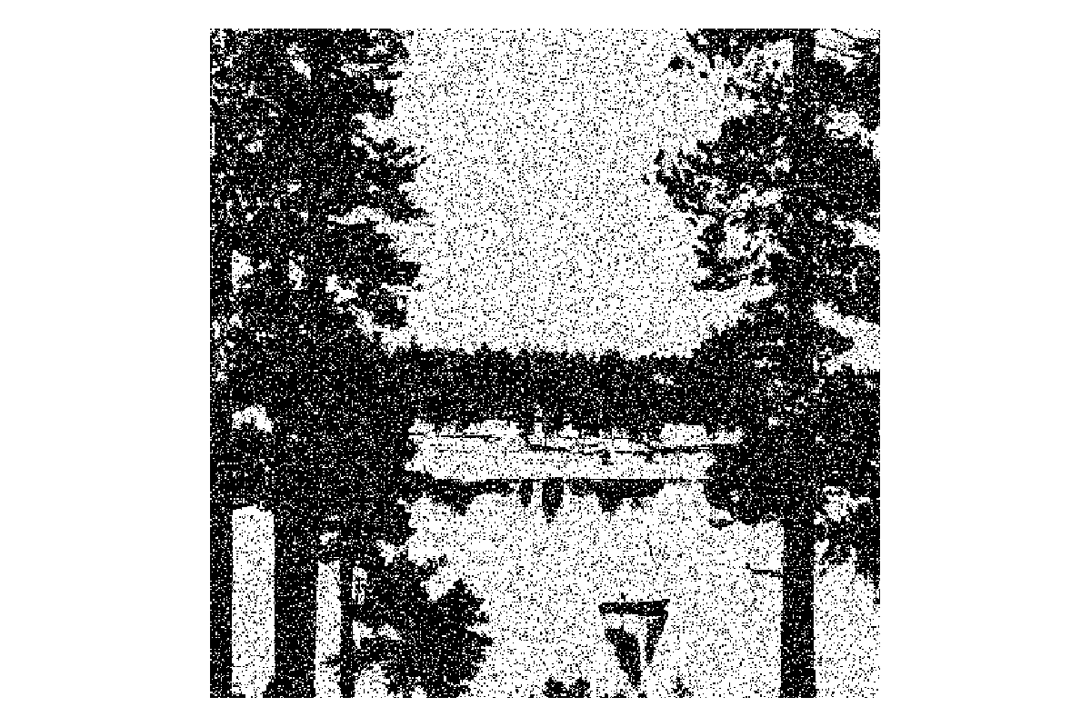

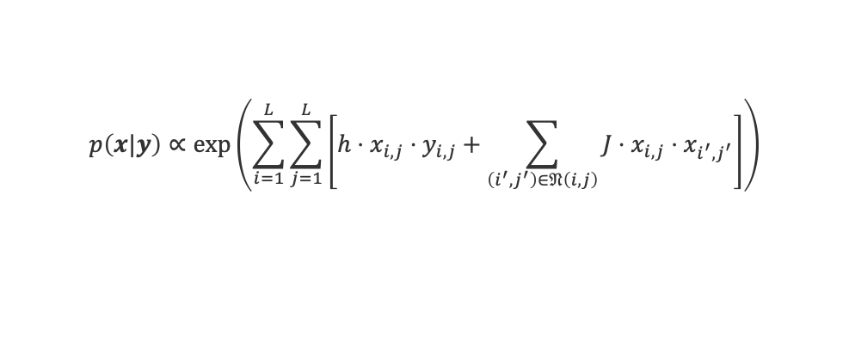

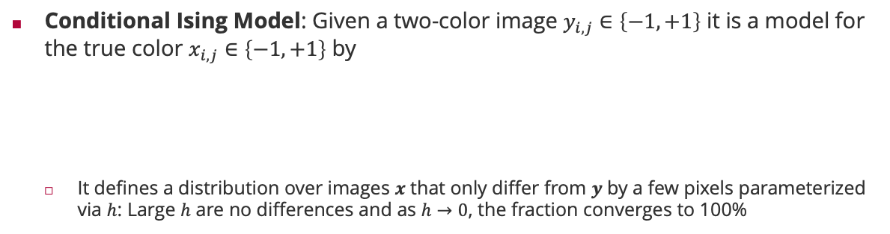



Marginalization by Sampling: Image Denoising Example
Conditional Ising Model: Given a two-color image $y_{i,j}∈\left\{−1,+1\right\}$ it is a model for the true color $x_{i,j}∈\left\{−1,+1\right\}$ by
It defines a distribution over images $x$ that only differ from $y$ by a few pixels parameterized via $h$: Large $h$ are no differences and as $h→0$, the fraction converges to 100%
Coupling strength that a pixel has the same label as its neighbours
$$p\left(x|y\right)∝\exp\left(\sum_{i=1}^{L}{\sum_{j=1}^{L}{\left[h⋅x_{i,j}⋅y_{i,j}+\sum_{\left(i^{′},j^{′}\right)∈𝔑\left(i,j\right)}{J⋅x_{i,j}⋅x_{i^{′},j^{′}}}\right]}}\right)$$
With zero coupling, $h=\frac{1}{2}⋅\log\left(\frac{p\left(x_{i,j}=y_{i,j}\right)}{1−p\left(x_{i,j}=y_{i,j}\right)}\right)$
$$h=10, J=0 (x=y)$$
$$h=1,J=0$$
$$h=1,J=2$$

Slide 14
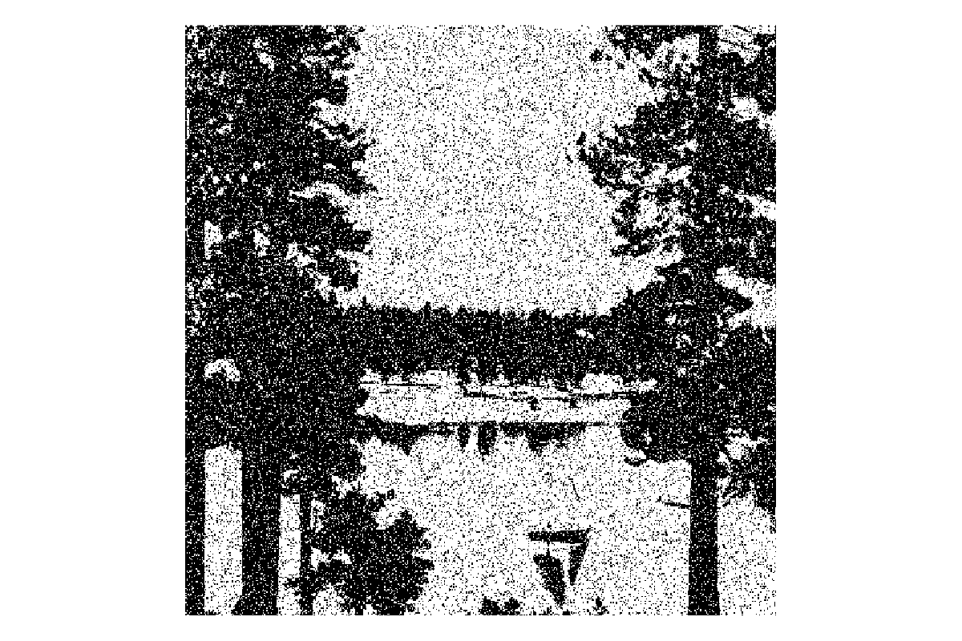


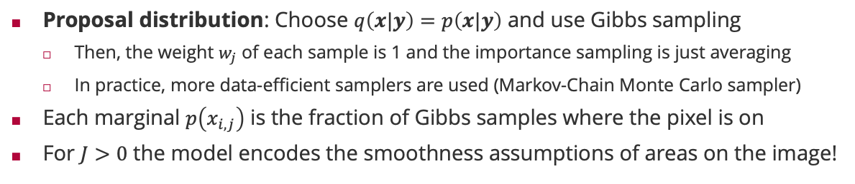


Marginalization by Sampling: Image Denoising Example (ctd)
Proposal distribution: Choose $q\left(x|y\right)=p\left(x|y\right)$ and use Gibbs sampling
Then, the weight $w_{j}$ of each sample is 1 and the importance sampling is just averaging
In practice, more data-efficient samplers are used (Markov-Chain Monte Carlo sampler)
Each marginal $p\left(x_{i,j}\right)$ is the fraction of Gibbs samples where the pixel is on
For $J>0$ the model encodes the smoothness assumptions of areas on the image!
Original $y$
With noise $y^{′}$
$$E\left[X|y^{′}\right]$$

Slide 15
Overview
Factor Graphs
Marginalization by Importance Sampling
Marginalization by the Sum-Product Algorithm
Practical Considerations in Message Passing
Application: Bayesian Regression

Slide 16
Marginalization using the Distributive Law
Observation 1: The marginal of a factor graph is a sum (over all values of all hidden variables) of a product (of factor functions).
Observation 2: Turning a sum of products with a common factor into a product of sums using the distributive law saves computation!
Observation 3: In a typical factor graph, functions only depend on a small number of variables.
$$p\left(x_{1}\right)=\sum_{x_{2}=0}^{1}{\sum_{x_{3}=0}^{1}{⋯\sum_{x_{n}=0}^{1}{f_{1}\left(x_{1},x_{2},…,x_{n}\right)⋅⋯⋅f_{m}\left(x_{1},x_{2},…,x_{n}\right)}}}$$
$$a⋅b+a⋅c=a⋅\left(b+c\right)$$
3 operations
2 operations

Slide 17
Sum-Product Algorithm: Non-normalized Marginals
$$f_{3}$$
$$f_{1}$$
$$f_{4}$$
$$X_{3}$$
$$X_{1}$$
$$f_{5}$$
$$f_{6}$$
$$f_{7}$$
$$X_{4}$$
$$X_{5}$$
$$f_{2}$$
$$m_{f_{5}→X_{4}}\left(x_{4}\right)$$
$$m_{f_{6}→X_{4}}\left(x_{4}\right)$$
$$X_{2}$$
Message $m_{f_{j}→X_{i}}\left(x_{i}\right)$ is the sum over all variables in the subtree rooted at $f_{j}$ with $X_{i}=x_{i}$
$$p_{X_{4}}\left(x_{4}\right)=\sum_{\left\{x_{1}\right\}}{\sum_{\left\{x_{2}\right\}}{\sum_{\left\{x_{3}\right\}}{\sum_{\left\{x_{5}\right\}}{f_{1}\left(x_{1}\right)⋅f_{2}\left(x_{2}\right)⋅f_{3}\left(x_{3}\right)⋅f_{4}\left(x_{1},x_{3}\right)⋅f_{5}\left(x_{2},x_{3},x_{4}\right)⋅f_{6}\left(x_{4},x_{5}\right)⋅f_{7}\left(x_{5}\right)}}}}$$
$$=\left[\sum_{\left\{x_{1}\right\}}{\sum_{\left\{x_{2}\right\}}{\sum_{\left\{x_{3}\right\}}{f_{1}\left(x_{1}\right)⋅f_{2}\left(x_{2}\right)⋅f_{3}\left(x_{3}\right)⋅f_{4}\left(x_{1},x_{3}\right)⋅f_{5}\left(x_{2},x_{3},x_{4}\right)}}}\right]⋅\left[\sum_{\left\{x_{5}\right\}}{f_{6}\left(x_{4},x_{5}\right)⋅f_{7}\left(x_{5}\right)}\right]$$
$$m_{f_{5}→X_{4}}\left(x_{4}\right)$$
$$m_{f_{6}→X_{4}}\left(x_{4}\right)$$
Non-normalized Marginals are the product of all incoming messages from neighbouring factors!

Slide 18
Sum-Product Algorithm: Message from Factor to Variable
$$f_{3}$$
$$f_{1}$$
$$f_{4}$$
$$X_{3}$$
$$m_{X_{3}→f_{5}}\left(x_{3}\right)$$
$$X_{1}$$
$$f_{5}$$
$$f_{6}$$
$$f_{7}$$
$$X_{4}$$
$$X_{5}$$
$$f_{2}$$
$$m_{f_{5}→X_{4}}\left(x_{4}\right)$$
$$m_{f_{6}→X_{4}}\left(x_{4}\right)$$
$$X_{2}$$
$$m_{X_{2}→f_{5}}\left(x_{2}\right)$$
Message $m_{X_{i}→f_{j}}\left(x_{i}\right)$ is the sum over all variables in the subtree rooted at $X_{i}$ with $X_{i}=x_{i}$
$$m_{f_{5}→X_{4}}\left(x_{4}\right)=\sum_{\left\{x_{1}\right\}}{\sum_{\left\{x_{2}\right\}}{\sum_{\left\{x_{3}\right\}}{f_{1}\left(x_{1}\right)⋅f_{2}\left(x_{2}\right)⋅f_{3}\left(x_{3}\right)⋅f_{4}\left(x_{1},x_{3}\right)⋅f_{5}\left(x_{2},x_{3},x_{4}\right)}}}$$
$$=\sum_{\left\{x_{2}\right\}}{\sum_{\left\{x_{3}\right\}}{f_{5}\left(x_{2},x_{3},x_{4}\right)⋅\left[f_{2}\left(x_{2}\right)\right]⋅\left[\sum_{\left\{x_{1}\right\}}{f_{1}\left(x_{1}\right)⋅f_{3}\left(x_{3}\right)⋅f_{4}\left(x_{1},x_{3}\right)}\right]}}$$
$$m_{X_{2}→f_{5}}\left(x_{2}\right)$$
$$m_{X_{3}→f_{5}}\left(x_{3}\right)$$
Messages from a factor to a variable sum out all neighboring variables weighted by their incoming message

Slide 19
Sum-Product Algorithm: Message from Variable to Factor
$$f_{3}$$
$$m_{f_{3}→X_{3}}\left(x_{3}\right)$$
$$f_{1}$$
$$f_{4}$$
$$X_{3}$$
$$m_{X_{3}→f_{5}}\left(x_{3}\right)$$
$$X_{1}$$
$$f_{5}$$
$$f_{6}$$
$$f_{7}$$
$$m_{f_{4}→X_{3}}\left(x_{3}\right)$$
$$X_{4}$$
$$X_{5}$$
$$f_{2}$$
$$m_{f_{5}→X_{4}}\left(x_{4}\right)$$
$$m_{f_{6}→X_{4}}\left(x_{4}\right)$$
$$X_{2}$$
$$m_{X_{2}→f_{5}}\left(x_{2}\right)$$
$$m_{X_{3}→f_{5}}\left(x_{3}\right)=\sum_{\left\{x_{1}\right\}}{f_{1}\left(x_{1}\right)⋅f_{3}\left(x_{3}\right)⋅f_{4}\left(x_{1},x_{3}\right)}$$
$$=\left[f_{3}\left(x_{3}\right)\right]⋅\left[\sum_{\left\{x_{1}\right\}}{f_{1}\left(x_{1}\right)⋅f_{4}\left(x_{1},x_{3}\right)}\right]$$
$$m_{f_{3}→X_{3}}\left(x_{3}\right)$$
$$m_{f_{4}→X_{3}}\left(x_{3}\right)$$
Messages from a variable to a factor multiply incoming message from neighboring factors

Slide 20

Sum-Product Algorithm
Sum-Product Algorithm (Aji-McEliece, 1997). Putting it all together, we have
Basis: Generalized distributive law (which also holds for max-product)
Efficiency: By storing messages, we
Only have to compute local summations in $O\left(2^{T}\right)$ where degree $T=\max_{f}\left|ne\left(f\right)\right|$!
All marginals can be computed recursively in $O\left(E⋅2^{T}\right)$ vs $O\left(2^{n}\right)$ (where $E$ is the number of edges of the factor graph)!
$$p_{X_{j}}\left(x_{j}\right)=\prod_{i∈ne\left(X_{j}\right)}{m_{f_{i}→X_{j}}\left(x_{j}\right)}$$
$$m_{f_{i}→X_{j}}\left(x_{j}\right)=\sum_{\left\{x_{ne\left(f_{i}\right)∖\left\{j\right\}}\right\}}{f\left(x_{ne\left(f_{i}\right)}\right)\prod_{k∈ne\left(f_{i}\right)∖\left\{j\right\}}{m_{X_{k}→f_{i}}\left(x_{k}\right)}}$$
$$m_{X_{j}→f_{k}}\left(x_{j}\right)=\prod_{i∈ne\left(X_{j}\right)∖\left\{k\right\}}{m_{f_{i}→X_{j}}\left(x_{j}\right)}$$
Robert McEliece (1942 – 2019)

Slide 21
Overview
Factor Graphs
Marginalization by Importance Sampling
Marginalization by the Sum-Product Algorithm
Practical Considerations in Message Passing
Application: Bayesian Regression

Slide 22
Even more efficiency
Redundancies. By the very definition of messages and non-normalized marginals
$$p_{X}\left(x\right)=\prod_{i∈ne\left(X\right)}{m_{f_{i}→X}\left(x\right)}=m_{f_{k}→X}\left(x\right)⋅\prod_{i∈ne\left(X\right)∖\left\{k\right\}}{m_{f_{i}→X}\left(x\right)}$$
Interpretation. Application of Bayes’ rule at a variable $X$ at factor $f$
$$p_{X}\left(x\right)=m_{f→X}\left(x\right)⋅m_{X→f}\left(x\right)$$
Storage Efficiency. We only store the marginals $p_{X}\left(x\right)$ and $m_{f→X}\left(x\right)$ because
$$m_{X→f}\left(x\right)=\frac{p_{X}\left(x\right)}{m_{f→X}\left(x\right)}$$
Exponential Family. If all the messages from factors to variables are in the exponential family, then the marginals and messages from the variable to factors are simply additions and subtraction of natural parameters (up to normalization)!
Example: If $p_{X}\left(x\right)=𝒢\left(x;τ_{1},ρ_{1}\right)$ and $m_{f→X}\left(x\right)=𝒢\left(x;τ_{2},ρ_{2}\right)$ then $m_{X→f}\left(x\right)∝𝒢\left(x;τ_{1}−τ_{2},ρ_{1}−ρ_{2}\right)$
$$m_{X→f_{k}}\left(x\right)$$
non-normalized posterior
Likelihood
non-normalized prior

Slide 23
A Practical Implementation
Initialize all messages $m_{f→X}\left(x\right)$ and marginals $p_{X}\left(x\right)$ with a constant function (i.e., uniform distribution)
Pick an arbitrary root (say, $X_{3}$)
Update all messages $m_{f→X}\left(x\right)$ from the leaves of the tree rooted at $X_{3}$upwards
Update all messages $m_{f→X}\left(x\right)$ from the root $X_{3}$to the leaves downwards
$$f_{1}\left(X_{1}\right)=𝕀\left(X_{1}=1\right)$$
$$f_{2}\left(X_{1},X_{2}\right)=\left\{\begin{aligned}1/2 X_{1}=X_{2} \\ 1/4 X_{1}≠X_{2}\end{aligned}\right.$$
$$f_{3}\left(X_{2},X_{3}\right)=\left\{\begin{aligned}1/2 X_{2}=X_{3} \\ 1/4 X_{2}≠X_{3}\end{aligned}\right.$$
$$X_{1}$$
$$X_{2}$$
$$X_{3}$$
$$m_{f_{1}→X_{1}}\left(⋅\right)$$
$$m_{f_{2}→X_{1}}\left(⋅\right)$$
$$m_{f_{2}→X_{2}}\left(⋅\right)$$
$$m_{f_{3}→X_{2}}\left(⋅\right)$$
$$m_{f_{3}→X_{3}}\left(⋅\right)$$
Update | $$p_{X_{1}}\left(⋅\right)$$ | $$p_{X_{2}}\left(⋅\right)$$ | $$p_{X_{3}}\left(⋅\right)$$ | $$m_{f_{1}→X_{1}}\left(⋅\right)$$ | $$m_{f_{2}→X_{1}}\left(⋅\right)$$ | $$m_{f_{2}→X_{2}}\left(⋅\right)$$ | $$m_{f_{3}→X_{2}}\left(⋅\right)$$ | $$m_{f_{3}→X_{3}}\left(⋅\right)$$
Initial | $$\left[\frac{1}{3},\frac{1}{3},\frac{1}{3}\right]$$ | $$\left[\frac{1}{3},\frac{1}{3},\frac{1}{3}\right]$$ | $$\left[\frac{1}{3},\frac{1}{3},\frac{1}{3}\right]$$ | $$\left[\frac{1}{3},\frac{1}{3},\frac{1}{3}\right]$$ | $$\left[\frac{1}{3},\frac{1}{3},\frac{1}{3}\right]$$ | $$\left[\frac{1}{3},\frac{1}{3},\frac{1}{3}\right]$$ | $$\left[\frac{1}{3},\frac{1}{3},\frac{1}{3}\right]$$ | $$\left[\frac{1}{3},\frac{1}{3},\frac{1}{3}\right]$$
Update | $$p_{X_{1}}\left(⋅\right)$$ | $$p_{X_{2}}\left(⋅\right)$$ | $$p_{X_{3}}\left(⋅\right)$$ | $$m_{f_{1}→X_{1}}\left(⋅\right)$$ | $$m_{f_{2}→X_{1}}\left(⋅\right)$$ | $$m_{f_{2}→X_{2}}\left(⋅\right)$$ | $$m_{f_{3}→X_{2}}\left(⋅\right)$$ | $$m_{f_{3}→X_{3}}\left(⋅\right)$$
Initial | $$\left[\frac{1}{3},\frac{1}{3},\frac{1}{3}\right]$$ | $$\left[\frac{1}{3},\frac{1}{3},\frac{1}{3}\right]$$ | $$\left[\frac{1}{3},\frac{1}{3},\frac{1}{3}\right]$$ | $$\left[\frac{1}{3},\frac{1}{3},\frac{1}{3}\right]$$ | $$\left[\frac{1}{3},\frac{1}{3},\frac{1}{3}\right]$$ | $$\left[\frac{1}{3},\frac{1}{3},\frac{1}{3}\right]$$ | $$\left[\frac{1}{3},\frac{1}{3},\frac{1}{3}\right]$$ | $$\left[\frac{1}{3},\frac{1}{3},\frac{1}{3}\right]$$
$$m_{f_{1}→X_{1}}\left(⋅\right)$$ | $$\left[1,0,0\right]$$ | $$\left[\frac{1}{3},\frac{1}{3},\frac{1}{3}\right]$$ | $$\left[\frac{1}{3},\frac{1}{3},\frac{1}{3}\right]$$ | $$\left[1,0,0\right]$$ | $$\left[\frac{1}{3},\frac{1}{3},\frac{1}{3}\right]$$ | $$\left[\frac{1}{3},\frac{1}{3},\frac{1}{3}\right]$$ | $$\left[\frac{1}{3},\frac{1}{3},\frac{1}{3}\right]$$ | $$\left[\frac{1}{3},\frac{1}{3},\frac{1}{3}\right]$$
Update | $$p_{X_{1}}\left(⋅\right)$$ | $$p_{X_{2}}\left(⋅\right)$$ | $$p_{X_{3}}\left(⋅\right)$$ | $$m_{f_{1}→X_{1}}\left(⋅\right)$$ | $$m_{f_{2}→X_{1}}\left(⋅\right)$$ | $$m_{f_{2}→X_{2}}\left(⋅\right)$$ | $$m_{f_{3}→X_{2}}\left(⋅\right)$$ | $$m_{f_{3}→X_{3}}\left(⋅\right)$$
Initial | $$\left[\frac{1}{3},\frac{1}{3},\frac{1}{3}\right]$$ | $$\left[\frac{1}{3},\frac{1}{3},\frac{1}{3}\right]$$ | $$\left[\frac{1}{3},\frac{1}{3},\frac{1}{3}\right]$$ | $$\left[\frac{1}{3},\frac{1}{3},\frac{1}{3}\right]$$ | $$\left[\frac{1}{3},\frac{1}{3},\frac{1}{3}\right]$$ | $$\left[\frac{1}{3},\frac{1}{3},\frac{1}{3}\right]$$ | $$\left[\frac{1}{3},\frac{1}{3},\frac{1}{3}\right]$$ | $$\left[\frac{1}{3},\frac{1}{3},\frac{1}{3}\right]$$
$$m_{f_{1}→X_{1}}\left(⋅\right)$$ | $$\left[1,0,0\right]$$ | $$\left[\frac{1}{3},\frac{1}{3},\frac{1}{3}\right]$$ | $$\left[\frac{1}{3},\frac{1}{3},\frac{1}{3}\right]$$ | $$\left[1,0,0\right]$$ | $$\left[\frac{1}{3},\frac{1}{3},\frac{1}{3}\right]$$ | $$\left[\frac{1}{3},\frac{1}{3},\frac{1}{3}\right]$$ | $$\left[\frac{1}{3},\frac{1}{3},\frac{1}{3}\right]$$ | $$\left[\frac{1}{3},\frac{1}{3},\frac{1}{3}\right]$$
$$m_{f_{2}→X_{2}}\left(⋅\right)$$ | $$\left[1,0,0\right]$$ | $$\left[\frac{1}{2},\frac{1}{4},\frac{1}{4}\right]$$ | $$\left[\frac{1}{3},\frac{1}{3},\frac{1}{3}\right]$$ | $$\left[1,0,0\right]$$ | $$\left[\frac{1}{3},\frac{1}{3},\frac{1}{3}\right]$$ | $$\left[\frac{1}{2},\frac{1}{4},\frac{1}{4}\right]$$ | $$\left[\frac{1}{3},\frac{1}{3},\frac{1}{3}\right]$$ | $$\left[\frac{1}{3},\frac{1}{3},\frac{1}{3}\right]$$
Update | $$p_{X_{1}}\left(⋅\right)$$ | $$p_{X_{2}}\left(⋅\right)$$ | $$p_{X_{3}}\left(⋅\right)$$ | $$m_{f_{1}→X_{1}}\left(⋅\right)$$ | $$m_{f_{2}→X_{1}}\left(⋅\right)$$ | $$m_{f_{2}→X_{2}}\left(⋅\right)$$ | $$m_{f_{3}→X_{2}}\left(⋅\right)$$ | $$m_{f_{3}→X_{3}}\left(⋅\right)$$
Initial | $$\left[\frac{1}{3},\frac{1}{3},\frac{1}{3}\right]$$ | $$\left[\frac{1}{3},\frac{1}{3},\frac{1}{3}\right]$$ | $$\left[\frac{1}{3},\frac{1}{3},\frac{1}{3}\right]$$ | $$\left[\frac{1}{3},\frac{1}{3},\frac{1}{3}\right]$$ | $$\left[\frac{1}{3},\frac{1}{3},\frac{1}{3}\right]$$ | $$\left[\frac{1}{3},\frac{1}{3},\frac{1}{3}\right]$$ | $$\left[\frac{1}{3},\frac{1}{3},\frac{1}{3}\right]$$ | $$\left[\frac{1}{3},\frac{1}{3},\frac{1}{3}\right]$$
$$m_{f_{1}→X_{1}}\left(⋅\right)$$ | $$\left[1,0,0\right]$$ | $$\left[\frac{1}{3},\frac{1}{3},\frac{1}{3}\right]$$ | $$\left[\frac{1}{3},\frac{1}{3},\frac{1}{3}\right]$$ | $$\left[1,0,0\right]$$ | $$\left[\frac{1}{3},\frac{1}{3},\frac{1}{3}\right]$$ | $$\left[\frac{1}{3},\frac{1}{3},\frac{1}{3}\right]$$ | $$\left[\frac{1}{3},\frac{1}{3},\frac{1}{3}\right]$$ | $$\left[\frac{1}{3},\frac{1}{3},\frac{1}{3}\right]$$
$$m_{f_{2}→X_{2}}\left(⋅\right)$$ | $$\left[1,0,0\right]$$ | $$\left[\frac{1}{2},\frac{1}{4},\frac{1}{4}\right]$$ | $$\left[\frac{1}{3},\frac{1}{3},\frac{1}{3}\right]$$ | $$\left[1,0,0\right]$$ | $$\left[\frac{1}{3},\frac{1}{3},\frac{1}{3}\right]$$ | $$\left[\frac{1}{2},\frac{1}{4},\frac{1}{4}\right]$$ | $$\left[\frac{1}{3},\frac{1}{3},\frac{1}{3}\right]$$ | $$\left[\frac{1}{3},\frac{1}{3},\frac{1}{3}\right]$$
$$m_{f_{3}→X_{3}}\left(⋅\right)$$ | $$\left[1,0,0\right]$$ | $$\left[\frac{1}{2},\frac{1}{4},\frac{1}{4}\right]$$ | $$\left[\frac{3}{8},\frac{5}{16},\frac{5}{16}\right]$$ | $$\left[1,0,0\right]$$ | $$\left[\frac{1}{3},\frac{1}{3},\frac{1}{3}\right]$$ | $$\left[\frac{1}{2},\frac{1}{4},\frac{1}{4}\right]$$ | $$\left[\frac{1}{3},\frac{1}{3},\frac{1}{3}\right]$$ | $$\left[\frac{3}{8},\frac{5}{16},\frac{5}{16}\right]$$
Update | $$p_{X_{1}}\left(⋅\right)$$ | $$p_{X_{2}}\left(⋅\right)$$ | $$p_{X_{3}}\left(⋅\right)$$ | $$m_{f_{1}→X_{1}}\left(⋅\right)$$ | $$m_{f_{2}→X_{1}}\left(⋅\right)$$ | $$m_{f_{2}→X_{2}}\left(⋅\right)$$ | $$m_{f_{3}→X_{2}}\left(⋅\right)$$ | $$m_{f_{3}→X_{3}}\left(⋅\right)$$
Initial | $$\left[\frac{1}{3},\frac{1}{3},\frac{1}{3}\right]$$ | $$\left[\frac{1}{3},\frac{1}{3},\frac{1}{3}\right]$$ | $$\left[\frac{1}{3},\frac{1}{3},\frac{1}{3}\right]$$ | $$\left[\frac{1}{3},\frac{1}{3},\frac{1}{3}\right]$$ | $$\left[\frac{1}{3},\frac{1}{3},\frac{1}{3}\right]$$ | $$\left[\frac{1}{3},\frac{1}{3},\frac{1}{3}\right]$$ | $$\left[\frac{1}{3},\frac{1}{3},\frac{1}{3}\right]$$ | $$\left[\frac{1}{3},\frac{1}{3},\frac{1}{3}\right]$$
$$m_{f_{1}→X_{1}}\left(⋅\right)$$ | $$\left[1,0,0\right]$$ | $$\left[\frac{1}{3},\frac{1}{3},\frac{1}{3}\right]$$ | $$\left[\frac{1}{3},\frac{1}{3},\frac{1}{3}\right]$$ | $$\left[1,0,0\right]$$ | $$\left[\frac{1}{3},\frac{1}{3},\frac{1}{3}\right]$$ | $$\left[\frac{1}{3},\frac{1}{3},\frac{1}{3}\right]$$ | $$\left[\frac{1}{3},\frac{1}{3},\frac{1}{3}\right]$$ | $$\left[\frac{1}{3},\frac{1}{3},\frac{1}{3}\right]$$
$$m_{f_{2}→X_{2}}\left(⋅\right)$$ | $$\left[1,0,0\right]$$ | $$\left[\frac{1}{2},\frac{1}{4},\frac{1}{4}\right]$$ | $$\left[\frac{1}{3},\frac{1}{3},\frac{1}{3}\right]$$ | $$\left[1,0,0\right]$$ | $$\left[\frac{1}{3},\frac{1}{3},\frac{1}{3}\right]$$ | $$\left[\frac{1}{2},\frac{1}{4},\frac{1}{4}\right]$$ | $$\left[\frac{1}{3},\frac{1}{3},\frac{1}{3}\right]$$ | $$\left[\frac{1}{3},\frac{1}{3},\frac{1}{3}\right]$$
$$m_{f_{3}→X_{3}}\left(⋅\right)$$ | $$\left[1,0,0\right]$$ | $$\left[\frac{1}{2},\frac{1}{4},\frac{1}{4}\right]$$ | $$\left[\frac{3}{8},\frac{5}{16},\frac{5}{16}\right]$$ | $$\left[1,0,0\right]$$ | $$\left[\frac{1}{3},\frac{1}{3},\frac{1}{3}\right]$$ | $$\left[\frac{1}{2},\frac{1}{4},\frac{1}{4}\right]$$ | $$\left[\frac{1}{3},\frac{1}{3},\frac{1}{3}\right]$$ | $$\left[\frac{3}{8},\frac{5}{16},\frac{5}{16}\right]$$
$$m_{f_{3}→X_{2}}\left(⋅\right)$$ | $$\left[1,0,0\right]$$ | $$\left[\frac{1}{2},\frac{1}{4},\frac{1}{4}\right]$$ | $$\left[\frac{3}{8},\frac{5}{16},\frac{5}{16}\right]$$ | $$\left[1,0,0\right]$$ | $$\left[\frac{1}{3},\frac{1}{3},\frac{1}{3}\right]$$ | $$\left[\frac{1}{2},\frac{1}{4},\frac{1}{4}\right]$$ | $$\left[\frac{1}{3},\frac{1}{3},\frac{1}{3}\right]$$ | $$\left[\frac{3}{8},\frac{5}{16},\frac{5}{16}\right]$$
Update | $$p_{X_{1}}\left(⋅\right)$$ | $$p_{X_{2}}\left(⋅\right)$$ | $$p_{X_{3}}\left(⋅\right)$$ | $$m_{f_{1}→X_{1}}\left(⋅\right)$$ | $$m_{f_{2}→X_{1}}\left(⋅\right)$$ | $$m_{f_{2}→X_{2}}\left(⋅\right)$$ | $$m_{f_{3}→X_{2}}\left(⋅\right)$$ | $$m_{f_{3}→X_{3}}\left(⋅\right)$$
Initial | $$\left[\frac{1}{3},\frac{1}{3},\frac{1}{3}\right]$$ | $$\left[\frac{1}{3},\frac{1}{3},\frac{1}{3}\right]$$ | $$\left[\frac{1}{3},\frac{1}{3},\frac{1}{3}\right]$$ | $$\left[\frac{1}{3},\frac{1}{3},\frac{1}{3}\right]$$ | $$\left[\frac{1}{3},\frac{1}{3},\frac{1}{3}\right]$$ | $$\left[\frac{1}{3},\frac{1}{3},\frac{1}{3}\right]$$ | $$\left[\frac{1}{3},\frac{1}{3},\frac{1}{3}\right]$$ | $$\left[\frac{1}{3},\frac{1}{3},\frac{1}{3}\right]$$
$$m_{f_{1}→X_{1}}\left(⋅\right)$$ | $$\left[1,0,0\right]$$ | $$\left[\frac{1}{3},\frac{1}{3},\frac{1}{3}\right]$$ | $$\left[\frac{1}{3},\frac{1}{3},\frac{1}{3}\right]$$ | $$\left[1,0,0\right]$$ | $$\left[\frac{1}{3},\frac{1}{3},\frac{1}{3}\right]$$ | $$\left[\frac{1}{3},\frac{1}{3},\frac{1}{3}\right]$$ | $$\left[\frac{1}{3},\frac{1}{3},\frac{1}{3}\right]$$ | $$\left[\frac{1}{3},\frac{1}{3},\frac{1}{3}\right]$$
$$m_{f_{2}→X_{2}}\left(⋅\right)$$ | $$\left[1,0,0\right]$$ | $$\left[\frac{1}{2},\frac{1}{4},\frac{1}{4}\right]$$ | $$\left[\frac{1}{3},\frac{1}{3},\frac{1}{3}\right]$$ | $$\left[1,0,0\right]$$ | $$\left[\frac{1}{3},\frac{1}{3},\frac{1}{3}\right]$$ | $$\left[\frac{1}{2},\frac{1}{4},\frac{1}{4}\right]$$ | $$\left[\frac{1}{3},\frac{1}{3},\frac{1}{3}\right]$$ | $$\left[\frac{1}{3},\frac{1}{3},\frac{1}{3}\right]$$
$$m_{f_{3}→X_{3}}\left(⋅\right)$$ | $$\left[1,0,0\right]$$ | $$\left[\frac{1}{2},\frac{1}{4},\frac{1}{4}\right]$$ | $$\left[\frac{3}{8},\frac{5}{16},\frac{5}{16}\right]$$ | $$\left[1,0,0\right]$$ | $$\left[\frac{1}{3},\frac{1}{3},\frac{1}{3}\right]$$ | $$\left[\frac{1}{2},\frac{1}{4},\frac{1}{4}\right]$$ | $$\left[\frac{1}{3},\frac{1}{3},\frac{1}{3}\right]$$ | $$\left[\frac{3}{8},\frac{5}{16},\frac{5}{16}\right]$$
$$m_{f_{3}→X_{2}}\left(⋅\right)$$ | $$\left[1,0,0\right]$$ | $$\left[\frac{1}{2},\frac{1}{4},\frac{1}{4}\right]$$ | $$\left[\frac{3}{8},\frac{5}{16},\frac{5}{16}\right]$$ | $$\left[1,0,0\right]$$ | $$\left[\frac{1}{3},\frac{1}{3},\frac{1}{3}\right]$$ | $$\left[\frac{1}{2},\frac{1}{4},\frac{1}{4}\right]$$ | $$\left[\frac{1}{3},\frac{1}{3},\frac{1}{3}\right]$$ | $$\left[\frac{3}{8},\frac{5}{16},\frac{5}{16}\right]$$
$$m_{f_{2}→X_{1}}\left(⋅\right)$$ | $$\left[1,0,0\right]$$ | $$\left[\frac{1}{2},\frac{1}{4},\frac{1}{4}\right]$$ | $$\left[\frac{3}{8},\frac{5}{16},\frac{5}{16}\right]$$ | $$\left[1,0,0\right]$$ | $$\left[\frac{1}{3},\frac{1}{3},\frac{1}{3}\right]$$ | $$\left[\frac{1}{2},\frac{1}{4},\frac{1}{4}\right]$$ | $$\left[\frac{1}{3},\frac{1}{3},\frac{1}{3}\right]$$ | $$\left[\frac{3}{8},\frac{5}{16},\frac{5}{16}\right]$$
$$m_{f_{2}→X_{2}}\left(x_{2}\right)=\sum_{x_{1}=1}^{3}{f_{2}\left(x_{1},x_{2}\right)⋅\frac{p_{X_{1}}\left(x_{1}\right)}{m_{f_{2}→X_{1}}\left(x_{1}\right)}}$$
$$m_{X_{1}→f_{2}}\left(x_{1}\right)$$

Slide 24
Overview
Factor Graphs
Marginalization by Importance Sampling
Marginalization by the Sum-Product Algorithm
Practical Considerations in Message Passing
Application: Bayesian Regression

Slide 25
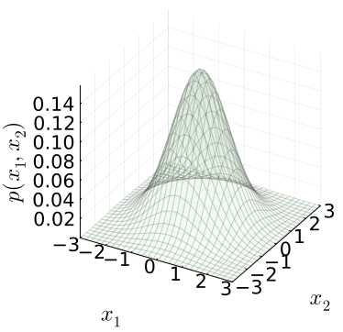
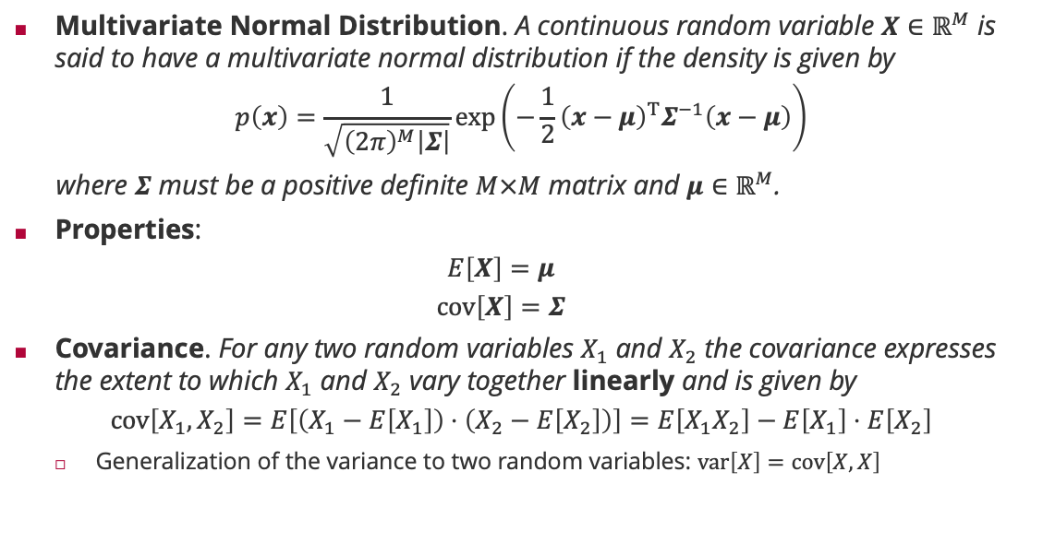
Multivariate Normal Distribution
Multivariate Normal Distribution. A continuous random variable $X∈ℝ^{M}$ is said to have a multivariate normal distribution if the density is given by
$$p\left(x\right)=\frac{1}{\sqrt{{\left(2π\right)}^{M}\left|Σ\right|}}\exp\left(−\frac{1}{2}{\left(x−μ\right)}^{T}Σ^{−1}\left(x−μ\right)\right)$$
where $Σ$ must be a positive definite $M×M$ matrix and $μ∈ℝ^{M}$.
Properties:
$$E\left[X\right]=μ$$
$$cov\left[X\right]=Σ$$
Covariance. For any two random variables $X_{1}$ and $X_{2}$ the covariance expresses the extent to which $X_{1}$ and $X_{2}$ vary together linearly and is given by
$$cov\left[X_{1},X_{2}\right]=E\left[\left(X_{1}−E\left[X_{1}\right]\right)⋅\left(X_{2}−E\left[X_{2}\right]\right)\right]=E\left[X_{1}X_{2}\right]−E\left[X_{1}\right]⋅E\left[X_{2}\right]$$
Generalization of the variance to two random variables: $var\left[X\right]=cov\left[X,X\right]$

Slide 26
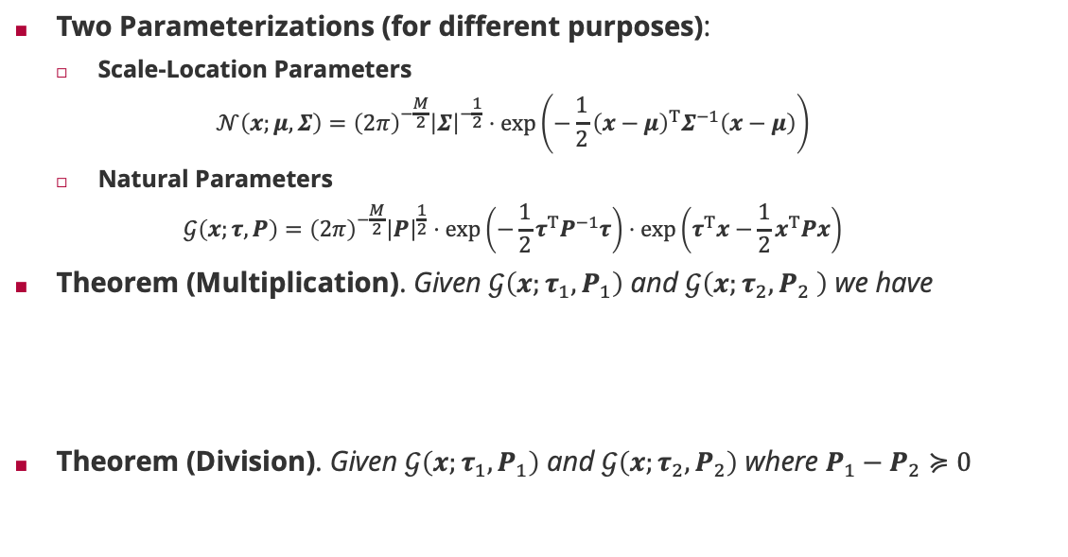



Multivariate Normal Distribution: Representations
Two Parameterizations (for different purposes):
Scale-Location Parameters
$$𝒩\left(x;μ,Σ\right)={\left(2π\right)}^{−\frac{M}{2}}{\left|Σ\right|}^{−\frac{1}{2}}⋅\exp\left(−\frac{1}{2}{\left(x−μ\right)}^{T}Σ^{−1}\left(x−μ\right)\right)$$
Natural Parameters
$$𝒢\left(x;τ,P\right)={\left(2π\right)}^{−\frac{M}{2}}{\left|P\right|}^{\frac{1}{2}}⋅\exp\left(−\frac{1}{2}τ^{T}P^{−1}τ\right)⋅\exp\left(τ^{T}x−\frac{1}{2}x^{T}Px\right)$$
Theorem (Multiplication). Given $𝒢\left(x;τ_{1},P_{1}\right)$ and $𝒢\left(x;τ_{2},P_{2} \right)$ we have
Theorem (Division). Given $𝒢\left(x;τ_{1},P_{1}\right)$ and $𝒢\left(x;τ_{2},P_{2}\right)$ where $P_{1}−P_{2}≽0$
$$𝒩\left(x;μ,Σ\right)=𝒢\left(x;Σ^{−1}μ,Σ^{−1}\right)$$
Matrix inverse
$$𝒢\left(x;τ,P\right)=𝒩\left(x;P^{−1}τ,P^{−1}\right)$$
$$𝒢\left(x;τ_{1},P_{1}\right)⋅𝒢\left(x;τ_{2},P_{2}\right)=𝒢\left(x;τ_{1}+τ_{2},P_{1}+P_{2}\right)⋅𝒩\left(μ_{1};μ_{2}, Σ_{1}+Σ_{2}\right)$$
Gaussian density
Additive updates!
$$\frac{𝒢\left(x;τ_{1},P_{1}\right)}{𝒢\left(x;τ_{2},P_{2}\right)}=\frac{𝒢\left(x;τ_{1}−τ_{2},P_{1}−P_{2}\right)}{𝒩\left(μ_{1};μ_{2},Σ_{2}−Σ_{1}\right)}⋅\frac{\left|Σ_{2}\right|}{\left|Σ_{2}−Σ_{1}\right|}$$
Correction factor
Subtractive updates!
Gaussian density

Slide 27




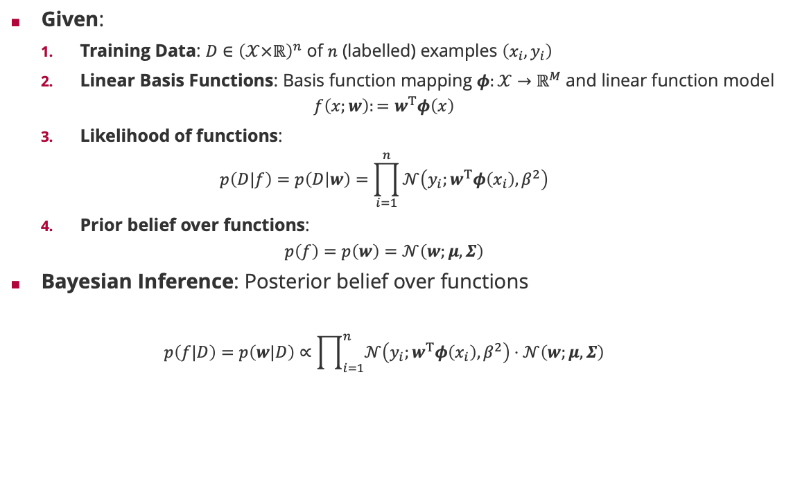



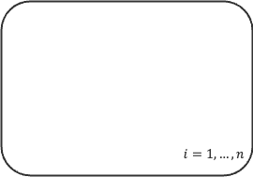


Bayesian Inference of Linear Basis Function Models
Given:
Training Data: $D∈{\left(𝒳×ℝ\right)}^{n}$ of $n$ (labelled) examples $\left(x_{i},y_{i}\right)$
Linear Basis Functions: Basis function mapping $φ:𝒳→ℝ^{M}$ and linear function model
$$f\left(x;w\right):=w^{T}φ\left(x\right)$$
Likelihood of functions:
$$p\left(D|f\right)=p\left(D | w\right)=\prod_{i=1}^{n}{𝒩\left(y_{i};w^{T}φ\left(x_{i}\right),β^{2}\right)}$$
Prior belief over functions:
$$p\left(f\right)=p\left(w\right)=𝒩\left(w;μ,Σ\right)$$
Bayesian Inference: Posterior belief over functions
$$p\left(f|D\right)=p\left(w|D\right)∝\prod_{i=1}^{n}{𝒩\left(y_{i};w^{T}φ\left(x_{i}\right),β^{2}\right)⋅𝒩\left(w;μ,Σ\right)}$$
Factor Graph
$$𝒩\left(W;μ,Σ\right)$$
$$W$$
feature vector
$$i=1,…,n$$
weight vector
Bayesian Network
$$δ\left(T_{i}−W^{T}φ\left(x_{i}\right) \right)$$
$$W$$
$$T_{i}$$
$$i=1,…,n$$
$X_{i}$
$$Y_{i}$$
$$𝒩\left(y_{i};T_{i},β^{2} \right)$$

Slide 28
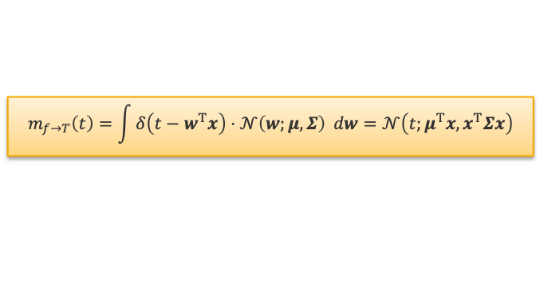
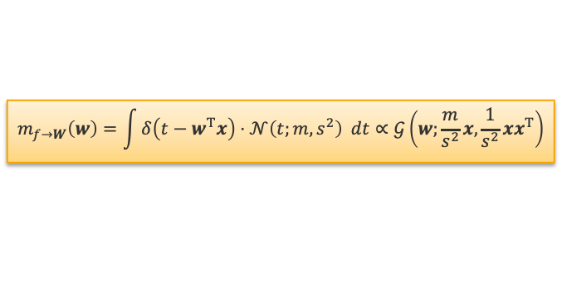






















Multivariate Message Update Equations
Gaussian Factor $𝒩\left(W;μ,Σ\right)$
Gaussian Projection Factor $δ\left({T−W}^{T}x\right)$
Factor Graph
$$𝒩\left(W;μ,Σ\right)$$
$$m_{f→W}\left(⋅\right)$$
$$𝒩\left(⋅;μ,Σ \right)$$
$$m_{f→T}\left(⋅\right)$$
$$W$$
$$W$$
$$T$$
$$W$$
$$i=1,…,n$$
$$m_{f→W}\left(w\right)=𝒩\left(w;μ,Σ\right)$$
$$m_{f→T}\left(t\right)=\int{δ\left(t−w^{T}x\right)⋅𝒩\left(w;μ,Σ\right) dw}=𝒩\left(t;μ^{T}x,x^{T}Σx\right)$$
$$δ\left(T_{i}−W^{T}φ\left(x_{i}\right) \right)$$
$$T_{i}$$
Gaussian Mean Factor $𝒩\left(Y;X,β^{2}\right)$
$$𝒩\left(y_{i};T_{i},β^{2} \right)$$
$$m_{f→W}\left(⋅\right)$$
$$𝒩\left(⋅;m,s^{2} \right)$$
$$𝒩\left(⋅;μ_{X},σ_{X}^{2}\right)$$
$$m_{f→Y}\left(⋅\right)$$
$$X$$
$$Y$$
$$W$$
$$T$$
$$m_{f→X}\left(⋅\right)$$
$$𝒩\left(⋅;μ_{Y},σ_{Y}^{2}\right)$$
$$m_{f→Y}\left(y\right)=𝒩\left(y;μ_{X},σ_{X}^{2}+β^{2}\right)$$
$$m_{f→W}\left(w\right)=\int{δ\left(t−w^{T}x\right)⋅𝒩\left(t;m,s^{2}\right) dt}∝𝒢\left(w;\frac{m}{s^{2}}x,\frac{1}{s^{2}}xx^{T}\right)$$
$$m_{f→X}\left(x\right)=𝒩\left(x;μ_{Y},σ_{Y}^{2}+β^{2}\right)$$

Slide 29


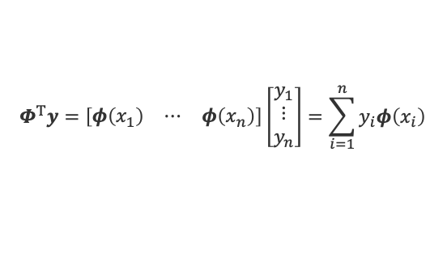






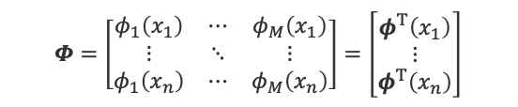





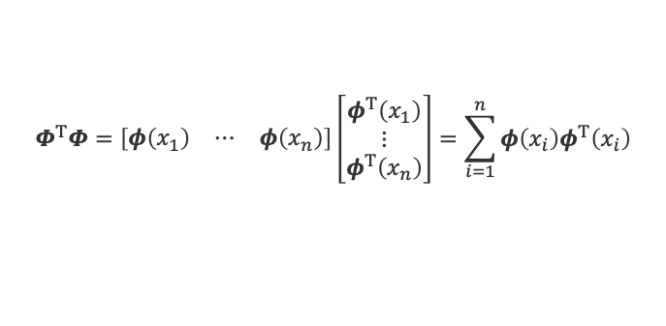



Bayesian Linear Regression by Message Passing
$$𝒩\left(W;μ,Σ\right)$$
Message: Simple factor tree where each training example is summarized in an $M$-dimensional message
Prior Message $m_{1,0}\left(w\right)=𝒢\left(w;Σ^{−1}μ,Σ^{−1}\right)=p\left(w\right)$
Target Message $m_{2,i}\left(t_{i}\right)=𝒩\left(y_{i};t_{i},β^{2}\right)=p\left(y_{i}|t_{i}\right)$
Data Message $m_{1,i}\left(w\right)=𝒢\left(w;β^{−2}y_{i}φ\left(x_{i}\right),β^{−2}φ\left(x_{i}\right)φ^{T} \left(x_{i}\right)\right)=p\left(y_{i}|w\right)$
Posterior: Multiplying prior and data messages we have
$$p\left(w|D\right)=𝒢\left(w;Σ^{−1}μ+β^{−2}\sum_{i=1}^{n}{y_{i}φ\left(x_{i}\right)},Σ^{−1}+β^{−2}\sum_{i=1}^{n}{φ\left(x_{i}\right)φ^{T} \left(x_{i}\right)}\right)$$
Feature Matrix: All feature vectors are stacked on top of each other in a feature matrix
$$m_{1,0}\left(⋅\right)$$
$$m_{1,1}\left(⋅\right)$$
$$W$$
$$m_{1,n}\left(⋅\right)$$
$$δ\left(T_{1}−W^{T}φ\left(x_{1}\right)\right)$$
$$δ\left(T_{n}−W^{T}φ\left(x_{n}\right)\right)$$
$$m_{2,1}\left(⋅\right)$$
$$m_{2,n}\left(⋅\right)$$
$$T_{1}$$
$$T_{n}$$
$$m_{2,1}\left(⋅\right)$$
$$m_{2,n}\left(⋅\right)$$
$$𝒩\left(y_{1};T_{1},β^{2}\right)$$
$$𝒩\left(y_{n};T_{n},β^{2}\right)$$
feature vector
$$Φ=\left[\begin{matrix}φ_{1}\left(x_{1}\right) & ⋯ & φ_{M}\left(x_{1}\right) \\ ⋮ & ⋱ & ⋮ \\ φ_{1}\left(x_{n}\right) & ⋯ & φ_{M}\left(x_{n}\right)\end{matrix}\right]=\left[\begin{matrix}φ^{T}\left(x_{1}\right) \\ ⋮ \\ φ^{T}\left(x_{n}\right)\end{matrix}\right]$$
$$Φ^{T}y=\left[\begin{matrix}φ\left(x_{1}\right) & ⋯ & φ\left(x_{n}\right)\end{matrix}\right]\left[\begin{matrix}y_{1} \\ ⋮ \\ y_{n}\end{matrix}\right]=\sum_{i=1}^{n}{y_{i}φ\left(x_{i}\right)}$$
$$Φ^{T}Φ=\left[\begin{matrix}φ\left(x_{1}\right) & ⋯ & φ\left(x_{n}\right)\end{matrix}\right]\left[\begin{matrix}φ^{T}\left(x_{1}\right) \\ ⋮ \\ φ^{T}\left(x_{n}\right)\end{matrix}\right]=\sum_{i=1}^{n}{φ\left(x_{i}\right)φ^{T}\left(x_{i}\right)}$$

Slide 30




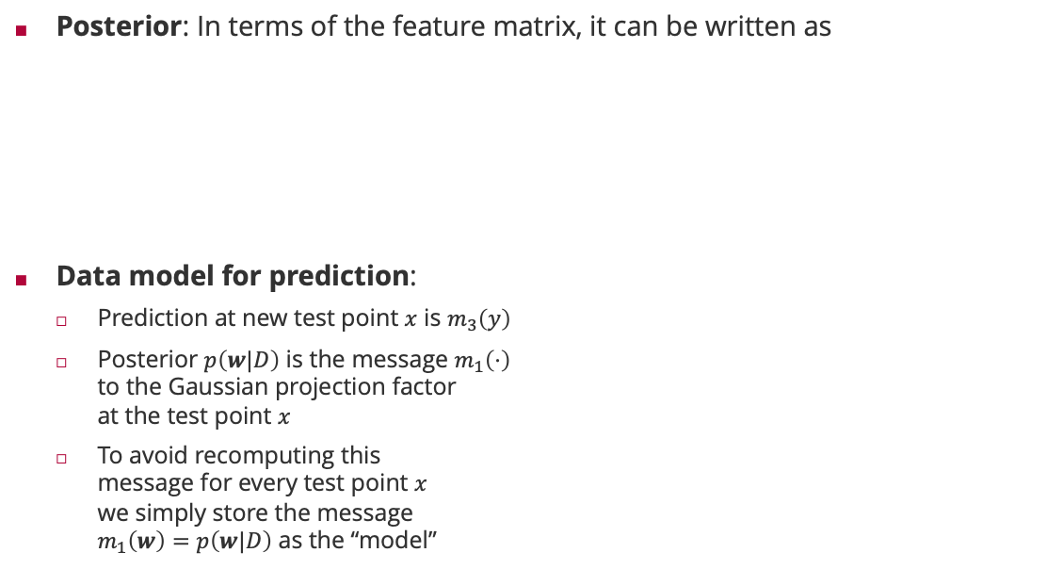























Bayesian Linear Regression: Training & Prediction
Posterior: In terms of the feature matrix, it can be written as
Data model for prediction:
Prediction at new test point $x$ is $m_{3}\left(y\right)$
Posterior $p\left(w|D\right)$ is the message $m_{1}\left(⋅\right)$ to the Gaussian projection factor at the test point $x$
To avoid recomputing this message for every test point $x$ we simply store the message $m_{1}\left(w\right)=p\left(w|D\right)$ as the “model”
$$p\left(w|D\right)=𝒢\left(w;Σ^{−1}μ+β^{−2}Φ^{T}y,Σ^{−1}+β^{−2}Φ^{T}Φ\right)$$
$$=𝒩\left(w;m, S\right)$$
$$S\left(Σ^{−1}μ+β^{−2}Φ^{T}y\right)$$
$${\left(Σ^{−1}+β^{−2}Φ^{T}Φ\right)}^{−1}$$
Posterior $p\left(w|D\right)$
$$𝒩\left(W;μ,Σ\right)$$
New test point
$$m_{1,0}\left(⋅\right)$$
$$m_{1}\left(⋅\right)$$
$$W$$
$$δ\left(T−W^{T}φ\left(x\right)\right)$$
$$m_{1,1}\left(⋅\right)$$
$$m_{1,n}\left(⋅\right)$$
$$m_{2}\left(⋅\right)$$
$$δ\left(T_{1}−W^{T}φ\left(x_{1}\right)\right)$$
$$δ\left(T_{n}−W^{T}φ\left(x_{n}\right)\right)$$
$$T$$
$$m_{2,1}\left(⋅\right)$$
$$m_{2,n}\left(⋅\right)$$
$$m_{2}\left(⋅\right)$$
$$T_{1}$$
$$T_{n}$$
$$𝒩\left(T;Y,β^{2}\right)$$
$$m_{2,1}\left(⋅\right)$$
$$m_{2,n}\left(⋅\right)$$
$$m_{3}\left(⋅\right)$$
$$Y$$
$$𝒩\left(y_{1}; T_{1},β^{2}\right)$$
$$𝒩\left(y_{n};T_{n},β^{2}\right)$$

Slide 31














Predictions
Predicition Tree: Simple factor chain given posterior $p\left(w|D\right)=𝒩\left(w;m,S\right)$
Posterior Message $m_{1}\left(w\right)=𝒩\left(w;m,S\right)=p\left(w|D\right)$
Projection Message $m_{2}\left(t\right)=𝒩\left(t;m^{T}φ\left(x\right),φ^{T}\left(x\right)⋅S⋅φ\left(x\right)\right)=p\left(t|x,D\right)$
Prediction Message $m_{3}\left(y\right)=𝒩\left(y;m^{T}φ\left(x\right),β^{2}+φ^{T}\left(x\right)⋅S⋅φ\left(x\right)\right)=p\left(y|x,D\right)$
Bayesian Linear Regression in Matrix Notation
$$𝒩\left(W;m,S\right)$$
$$m_{1}\left(⋅\right)$$
$$W$$
$$m_{1}\left(⋅\right)$$
$$δ\left(T−W^{T}φ\left(x\right)\right)$$
$$m_{2}\left(⋅\right)$$
$$T$$
$$m_{2}\left(⋅\right)$$
Training
$$S={\left(Σ^{−1}+β^{−2}Φ^{T}Φ\right)}^{−1}$$
$$m=S⋅\left(Σ^{−1}μ+β^{−2}Φ^{T}y\right)$$
$$𝒩\left(Y;T,β^{2}\right)$$
$$m_{3}\left(⋅\right)$$
$$Y$$
Prediction
$$p\left(y|x,D\right)=𝒩\left(y;m^{T}φ\left(x\right),β^{2}+φ^{T}\left(x\right)⋅S⋅φ\left(x\right) \right)$$
data uncertainty
model uncertainty

Slide 32
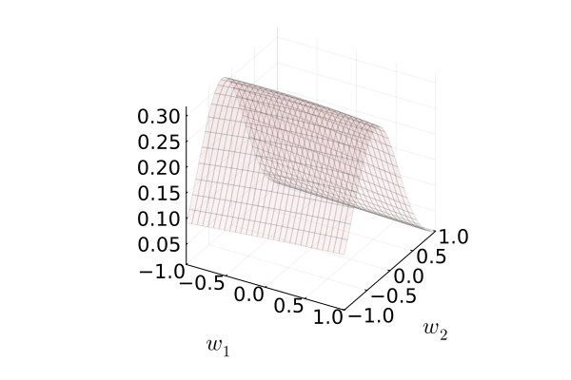
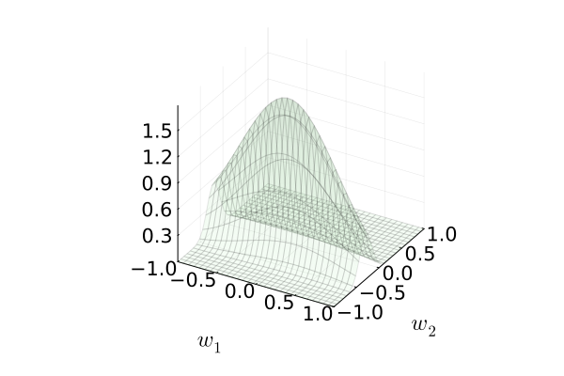
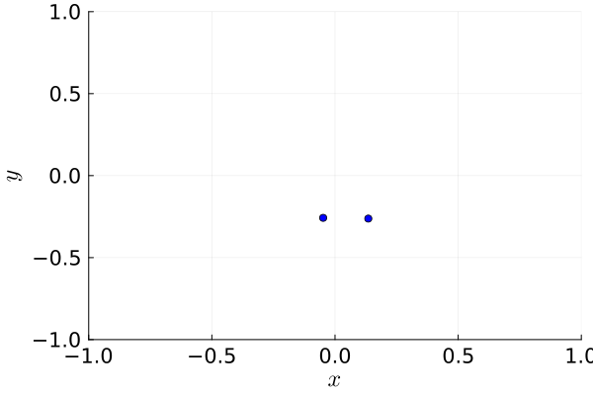
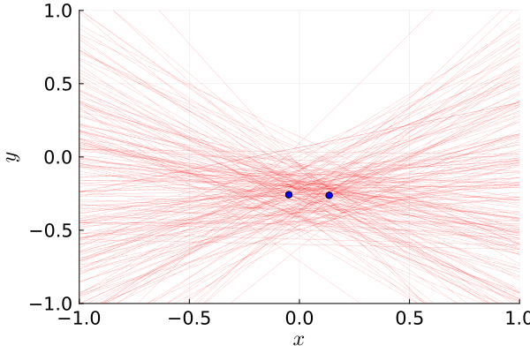
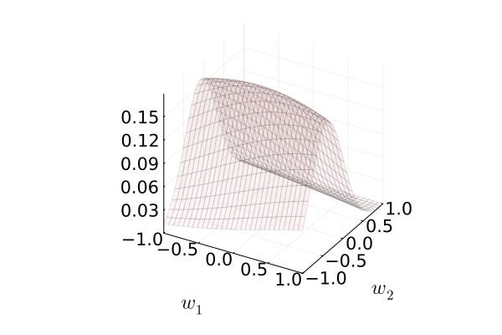
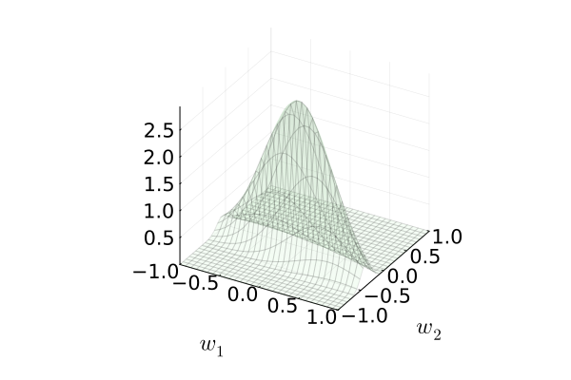
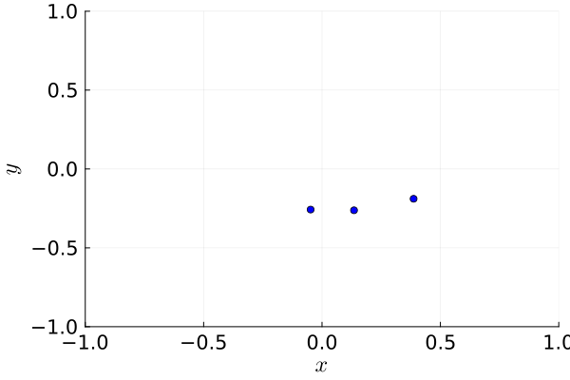
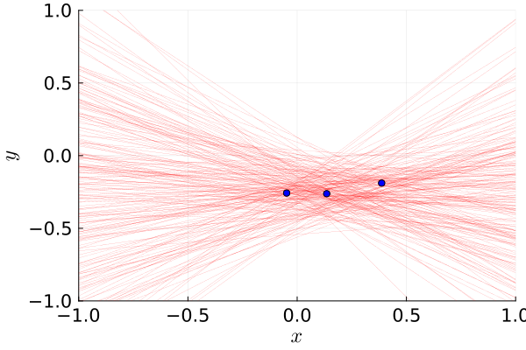
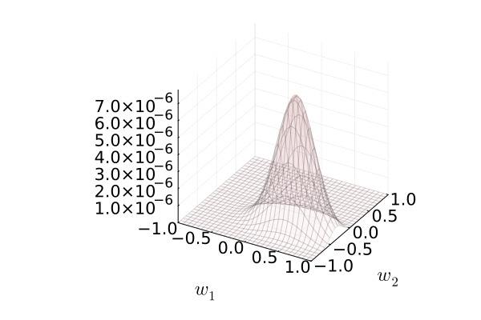
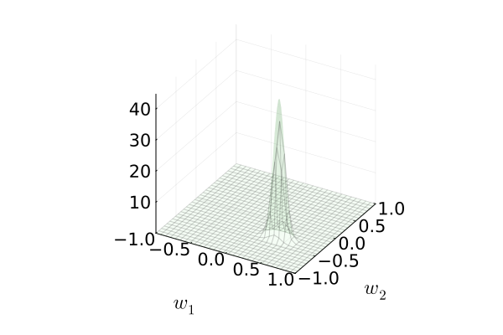
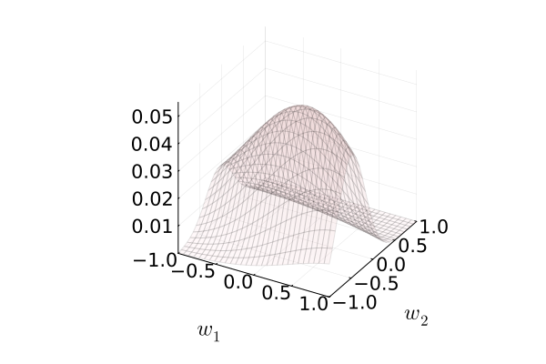
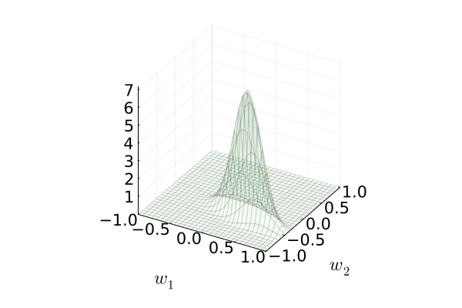
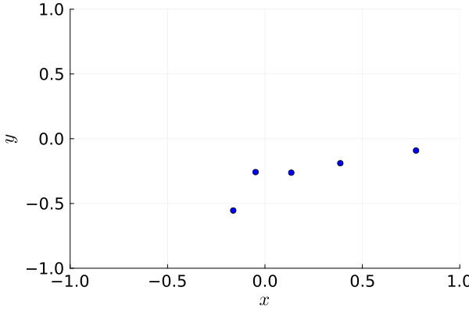
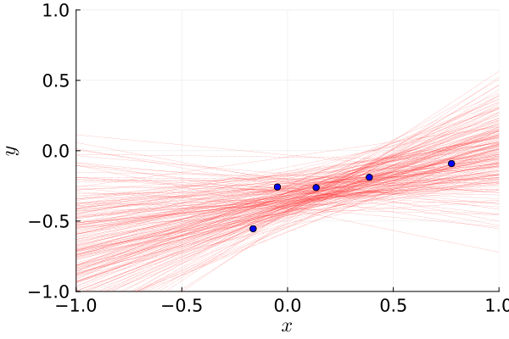
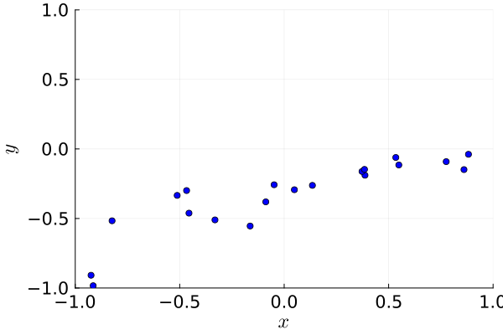
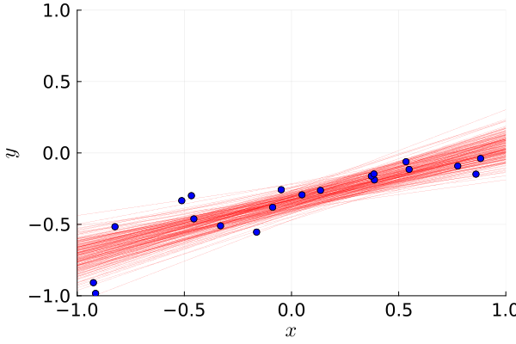







Bayesian Linear Regression: Learning
Likelihood
Posterior
Input Space
$$n=2$$
$$f\left(x;w\right)=w_{1}x+w_{2}$$
$$p\left(y|x;w\right)=𝒩\left(y;f\left(x\right),{0.2}^{2} \right)$$
$$p\left(w_{j}\right)=𝒩\left(w_{j};0,0.5\right)$$
$$n=3$$
$$n=5$$
$$n=20$$

Slide 33




Bayesian Linear Regression: Learning and Prediction
$$p\left(w\right)=𝒩\left(w;0,λ^{2}I\right)$$
$$λ=10$$
$$λ=1$$
Gaussian Basis
$$φ_{j}\left(x\right)=𝒩\left(x;j,{0.15}^{2}\right)$$
Polynomial Basis
$$φ_{j}\left(x\right)=x^{j}$$

Slide 34
Summary
Factor Graphs
Generalization of graphical models specifically designed for fast and easy inference
Date back to coding algorithms
Marginalization by Importance Sampling
An easy-to-implement sampling algorithm for the marginal distributions
Efficiency depends on the “match” of the proposal distributions with marginal distributions
Marginalization by the Sum-Product Algorithm
Application of generalized distributive law which trades memory (“messages”) for computation (“sums”)
Reduces the computational complexity to exponential in the largest out-degree of a factor!
There is no faster, exact algorithm for marginalization!
Bayesian Linear Regression
Message passing on the Bayesian Regression factor graph involves no loops and is exact
For linear basis function models with Normal noise, the posterior can be computed in closed form as a multivariate Gaussian whose variance accounts for model uncertainty

Slide 35
See you next week!

